Slide 1


Slide 2
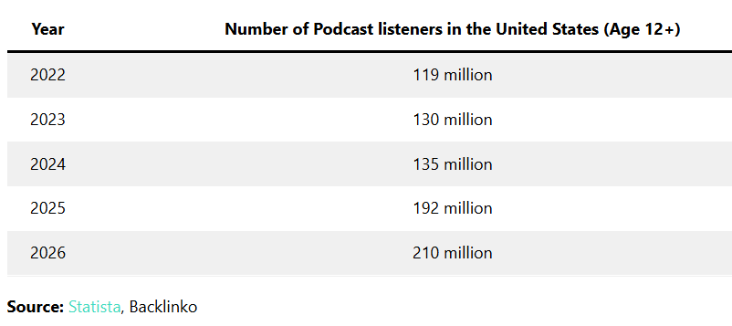
Are podcasts the wave of the future?
73% of Americans (210 million, ages 12+) listen to podcasts (Infinite Dial,2022)
The number of worldwide podcast listeners will reach 619.2 million in 2026 (DemandSage, 2026)
55% of Americans listened to a podcast in the last month and 40% in the last week (Edison Research)
There are over 5 million podcasts with over 70 million episodes in the world as of April 2026.

Slide 3
Audience
66% of monthly U.S. podcast listeners are aged between 12-34, 61% between 35 and 54 years old, and 38% are aged over 55. (DemandSage)
In 2019, around half of monthly podcast listeners had a full-time job (51%).
74% of podcast listeners tune in to learn new things, for entertainment, to keep up to date, to relax, and for inspiration.
Almost 50% of non-listeners say they don’t know where to find podcasts.
Ensuring your show is engaging and offers value is essential.

Slide 4




Record 1st episode
The steps to starting a podcast!
Concept, name, trademark
Promote
Artwork
Listing
09.05.XX
Edit
Format, recording equipment, software
Hosting site
Launch, plan &
grow!
Notes:
Develop a concept, name, trademark
Choose your format, recording equipment, software
Record your first episode
Edit your audio
Create your artwork
Set up your podcast at your hosting site
Get listed - Apple Podcasts, Google Podcasts, & Spotify
Launch, grow, and plan for the future!

Slide 5
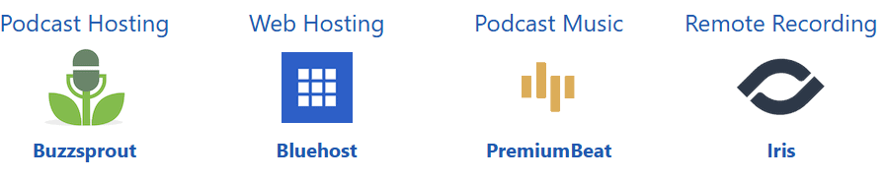
Determine your Host Site

Slide 6
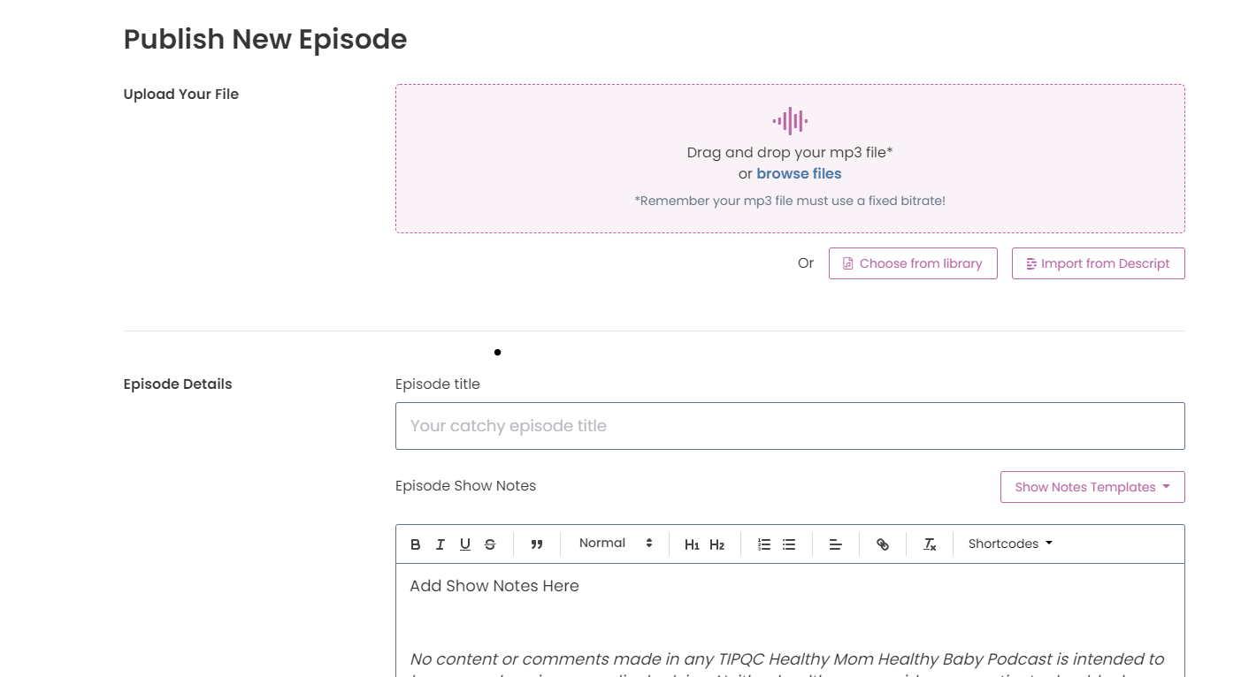

TIPQC Host & Analytics
TIPQC uses Captivate to upload podcast and track analytics
www.captivate.fm
Captivate allows the user to see analytics such as: unique listeners, episode downloads, location of listeners, etc.
Cost: $528 per year
Plan: Professional

Slide 7
Podcast Planning
Focus of episodes rotate between maternal and infant topics.
Most episodes are moderated by TIPQC Infant and Maternal Medical Directors. Occasionally, guest will host episodes on special topics when requested.
Episode planning occurs during weekly TIPQC faculty meetings.
Episodes are typically recorded at least 3 weeks in advanced, to allow for ample time for editing.

Slide 8

The Details
Podcast “seasons” are 15 weeks, with one episode per week, releasing on Friday.
Totals to 45 episodes per year.

Slide 9

Recording
Podcast are recorded on Squadcast.fm
Cost: $450 per year
Plan: Pro Audio

Slide 10
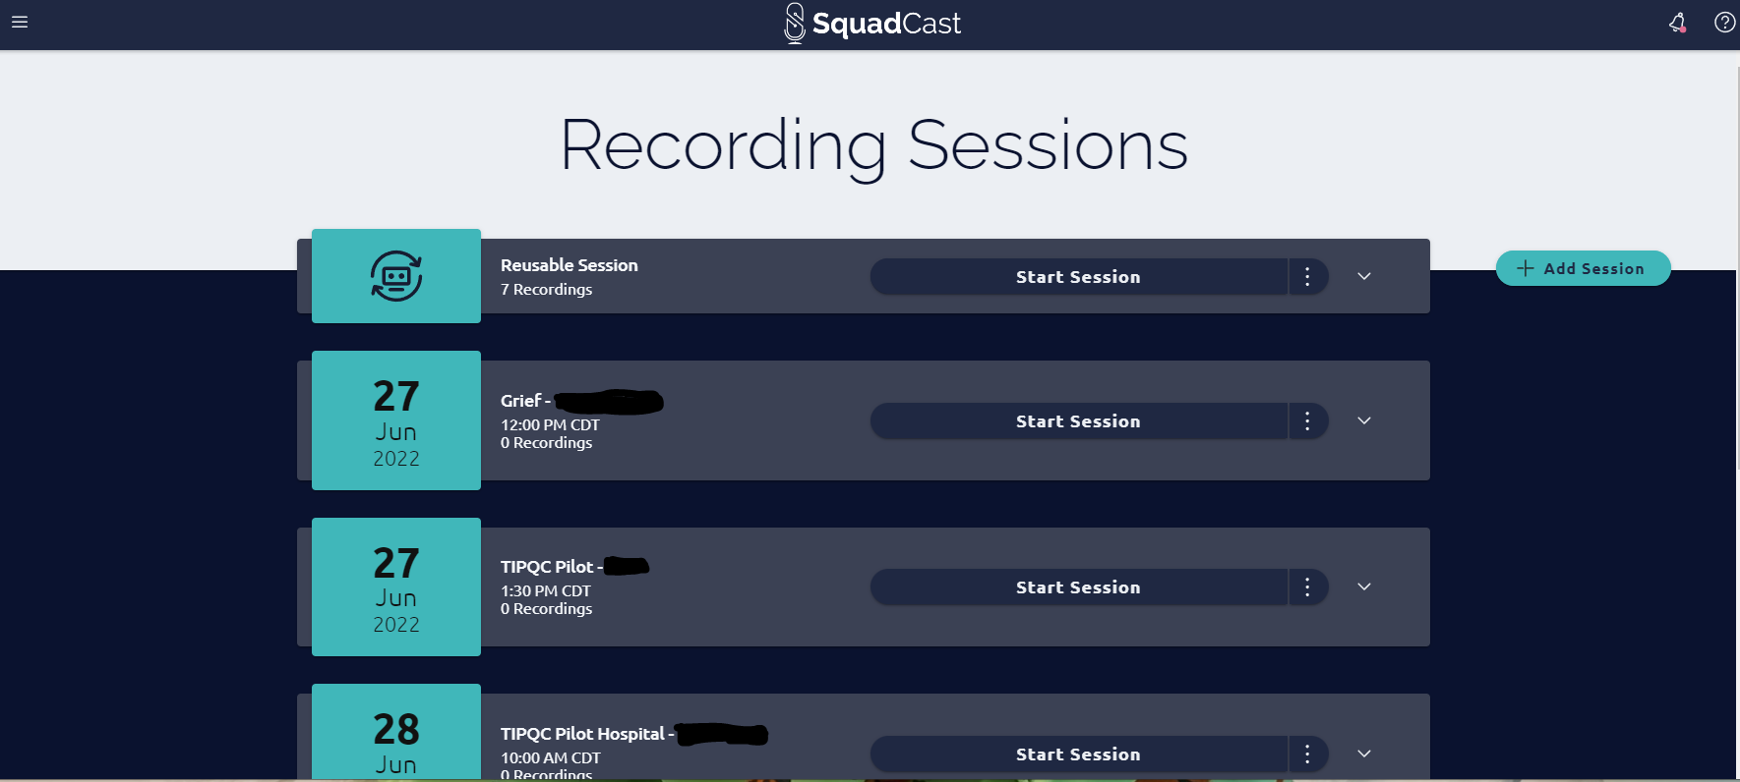
Recording
Squadcast allows the user to record audio in advance

Slide 11
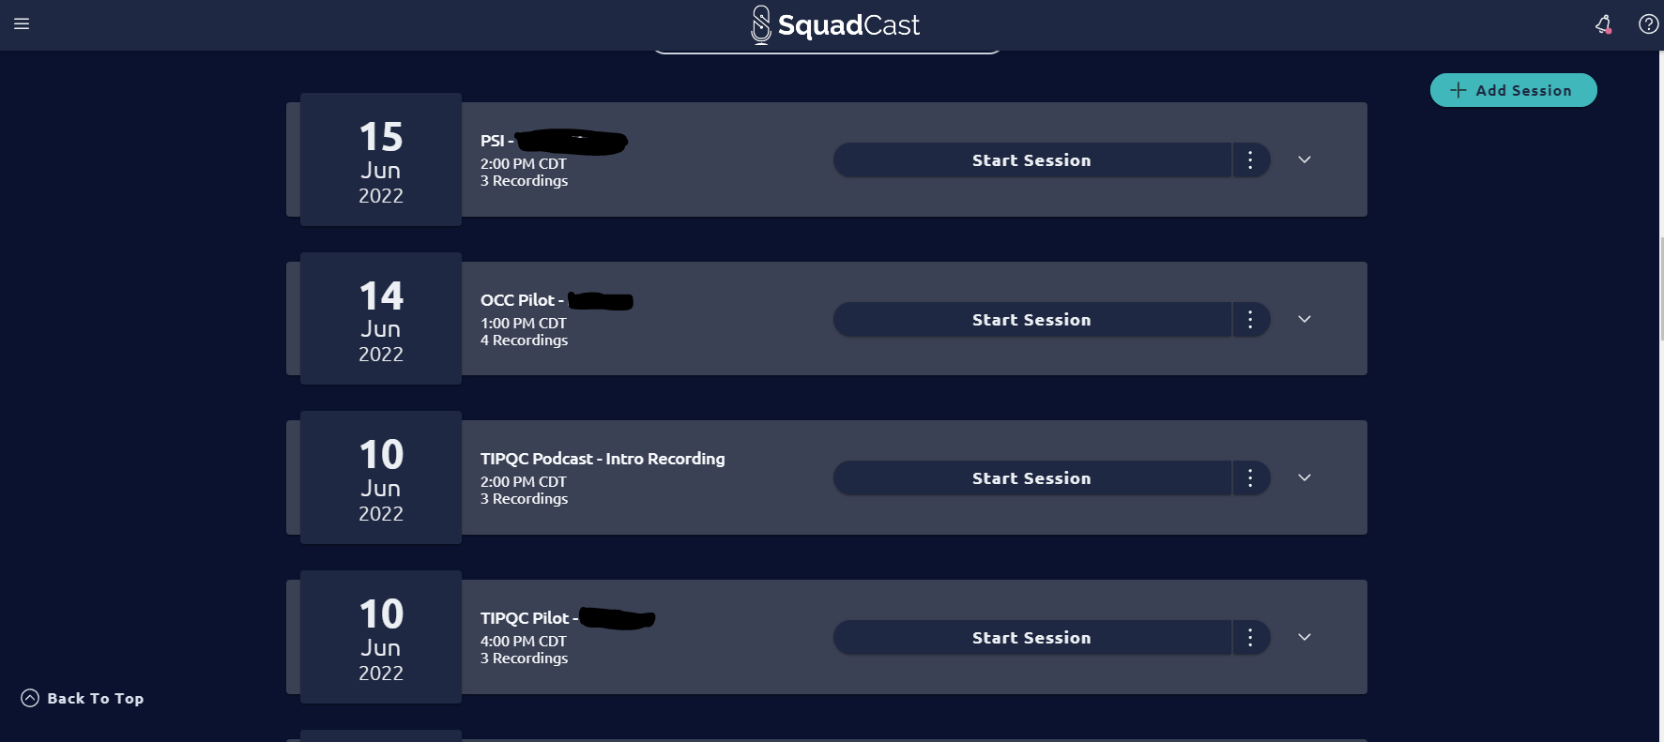
Recording
Squadcast also keeps past recording on site

Slide 12
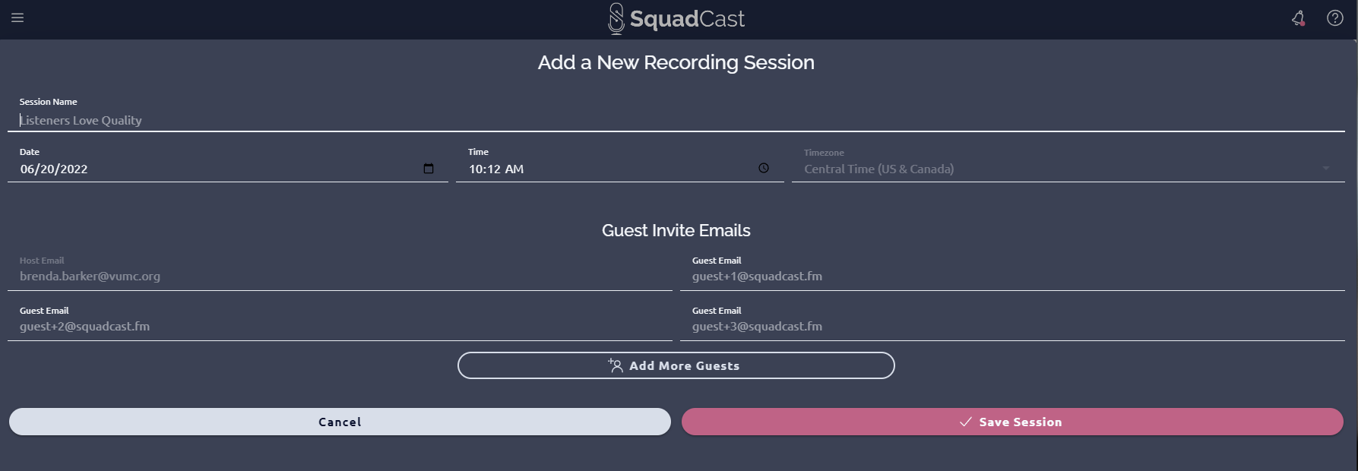
Recording
Invites are sent directly to the podcast guest once recordings are scheduled

Slide 13
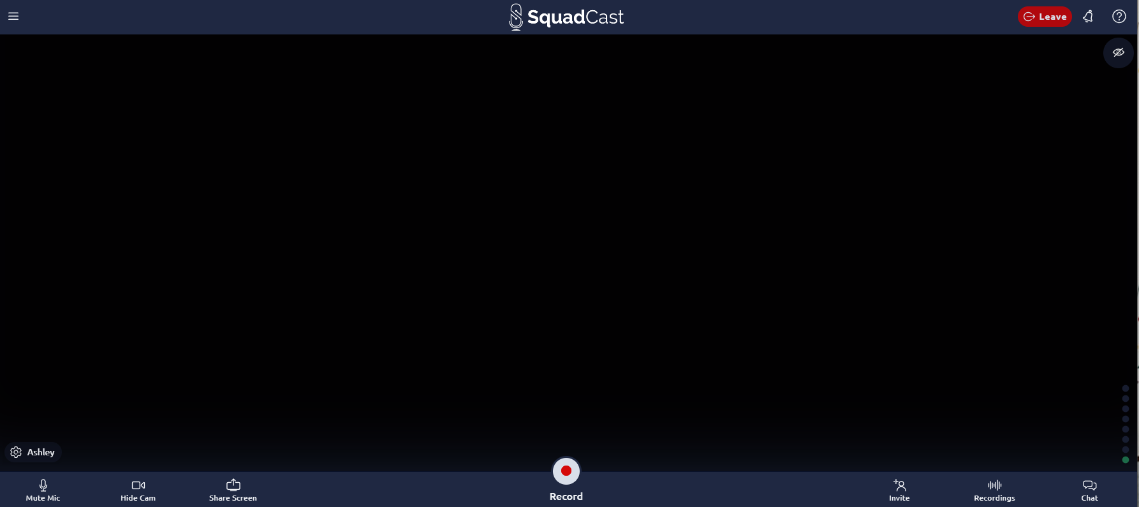
Recording
TIPQC releases audio-only episodes. When recording, Squadcast allows for video chat – which helps produce a more natural sounding conversation

Slide 14
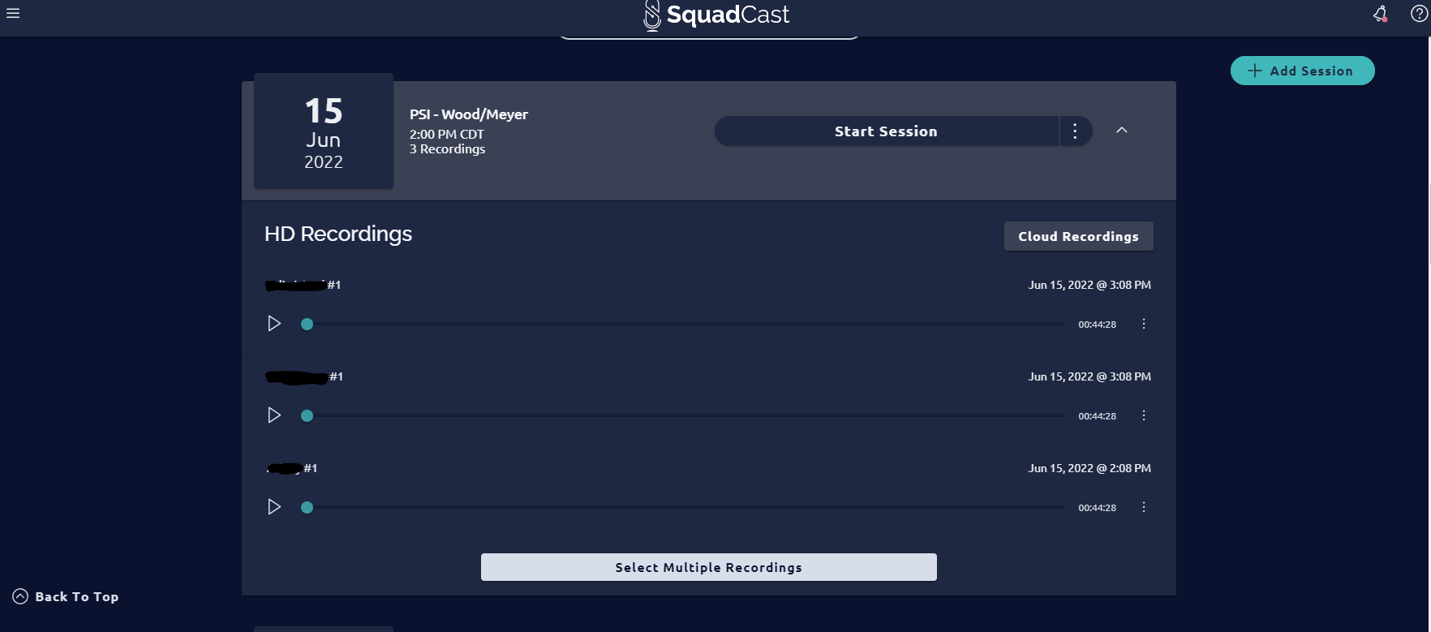
Recording
When recordings are completed – Squadcast saves each guest as an individual file for download – which allows for easier editing

Slide 15

Editing Options
Episodes can be edited on Descript.com by TIPQC staff
$- free with Squadcast

Slide 16
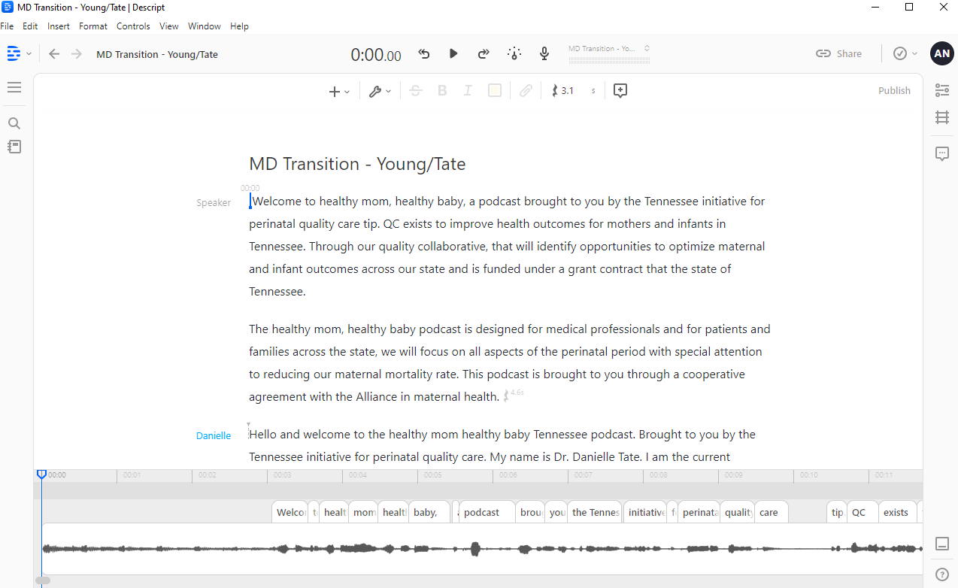
Editing
Descript will combine and transcribe audio files for editing

Slide 17
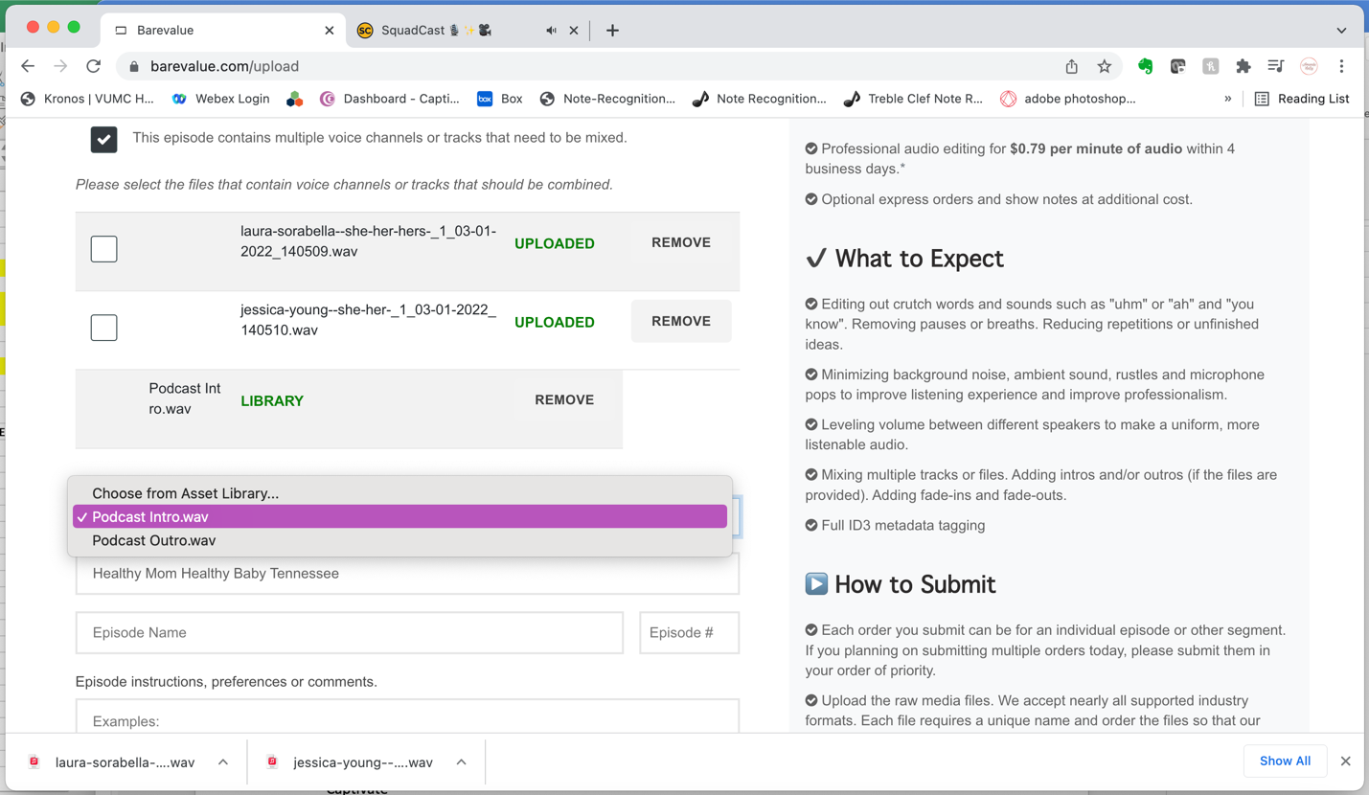

Editing
Podcasts are sent to Bare Value for editing when needed
www.barevalue.com
Cost: Approximately $47.40 per episode based on length

Slide 18
Marketing
The average podcast length - 25 and 30 minutes
Looking at Buzzsprout’s monthly podcast download numbers, if you get around 25-30 downloads a month, you’re already in the top 50% of podcasters.
TIPQC Analytics for most listens:
1st- 10-11 on Wednesdays
2nd- 10-11 on Fridays
3rd-- 5-6 on Fridays
Share your podcast across your social media accounts
Your cover art is the first thing potential listeners see. Good artwork implies quality content - 62% of new listeners are more likely to listen to a podcast if they like its cover art.

Slide 19

Advertising
Episodes are advertised on TIPQC’s social media platforms: Facebook, Twitter, LinkedIn, and Instagram.
An email alert is also sent to subscribers via MyEmma.

Slide 20

Advertising
Graphics for podcast advertising are designed on Canva.
www.Canva.com
Cost: $120 annually

Slide 21
Cost Breakdown
Services:
Squadcast $450
BareValue $1500
Captivate $528
Canva $120
=$2598
Staff:
Episode prep (1 hour)
Recording (~1 hour)
Editing (~4 hours)
Equipment:
Headphones
Microphone
(one-time purchase)
Total: 45 episodes/year averages about $250 per episode

