Slide 1


PRE-Test
While we wait to get started, please complete the pre-test survey

Slide 2
Welcome!
Respectful Care SIMS

Slide 3
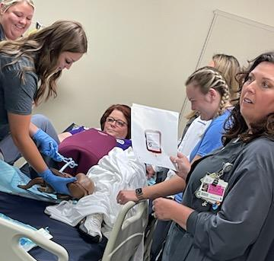
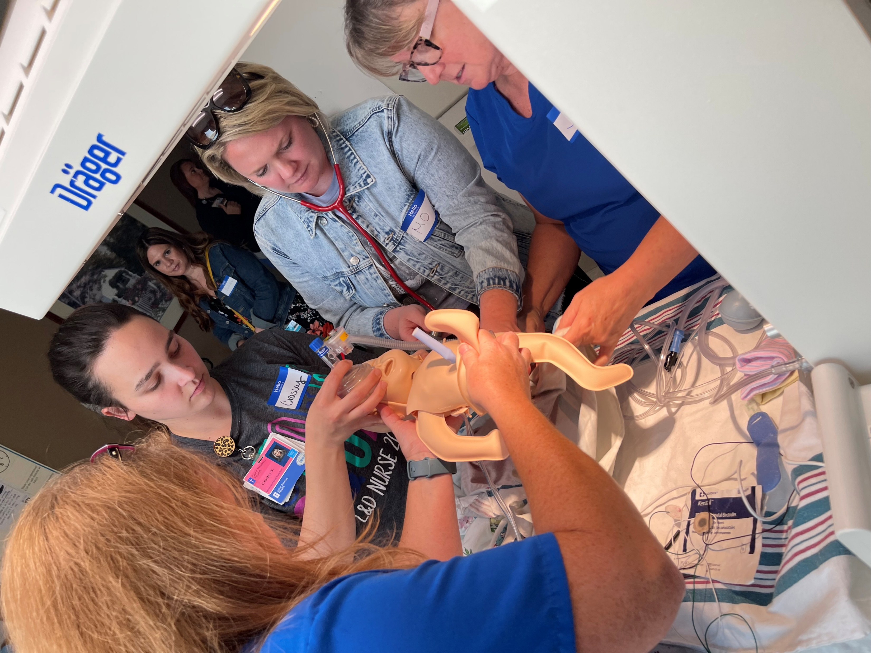
TIPQC Summer SIMS
2020
2021
2022
2023
2024- AWHONN OB Emergencies
2025

Slide 4

Today’s Agenda

Slide 5
Trauma-Informed Care
Bonnie Miller, MSN, RN, C-EFM, C-REC, SpBAP
Notes:
Trauma-informed care is a patient-centered approach to healthcare that recognizes the impact of trauma on individuals' physical and mental well-being. It emphasizes creating safe, supportive, and engaging environments for both patients and staff, and avoids actions or practices that could potentially re-traumatize individuals.

Slide 6
Three Key Objectives:
Prevalence of Trauma and Types of Trauma
What does Trauma-Informed Care look like
Tips for Preventing Re-Traumatization

Slide 7

Notes:
Trauma is the emotional response to a time-based event that leads to an intense fear of your own or a loved one’s death, injury, or serious illness.

Slide 8

The prevalence of trauma
The CDC statistics on abuse and violence
  one in four children experiences some sort of maltreatment (physical, sexual, or emotional abuse).
  One in four women has experienced domestic violence.
  one in five women and one in 71 men have experienced rape
    12% of these women and 30% of these men were younger than 10 years old when they were raped.
Notes:
Medical exams by definition can feel invasive. They often involve asking sensitive questions, examining intimate body parts, and sometimes delivering uncomfortable — even painful — treatments. So, it is important that healthcare providers are mindful of the fact that so many people come to that healthcare interaction with a history of trauma. This means that a significant number have people have experienced trauma in their life.
The CDC statistics on abuse and violence in the United States are sobering.
They report that one in four children experiences some sort of maltreatment (physical, sexual, or emotional abuse).
One in four women has experienced domestic violence.
In addition, one in five women and one in 71 men have experienced rape at some point in their lives — 12% of these women and 30% of these men were younger than 10 years old when they were raped.
Types of Trauma
Acute
Chronic
Complex
Secondary/Compassion Fatigue

Slide 9



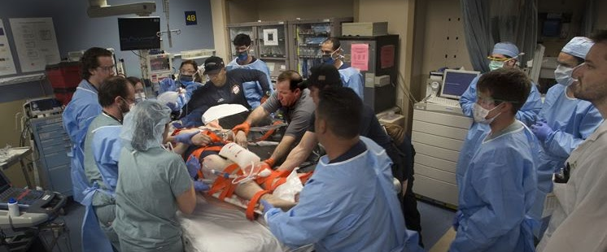
Acute Trauma
Acute trauma results from exposure to a single overwhelming event.
This Photo by Unknown author is licensed under CC BY-NC-ND.
Notes:
Examples:
Rape,
death of a loved one,
natural disaster.​
Characteristics:
Detailed memories,
omens,
hyper-vigilance,
exaggerated startle response,
misperceptions
or overreactions.​

Slide 10




Chronic Trauma
Notes:
Results from extended exposure to traumatizing situations.
Examples:
Prolonged exposure to violence or bullying,
profound neglect,
series of home removals.
Characteristics:
Denial and psychological numbing,
Dissociation
(disconnecting from one’s thoughts, feelings, memories or sense of identity.),
rage,
social withdrawal,
sense of foreshortened future.

Slide 11
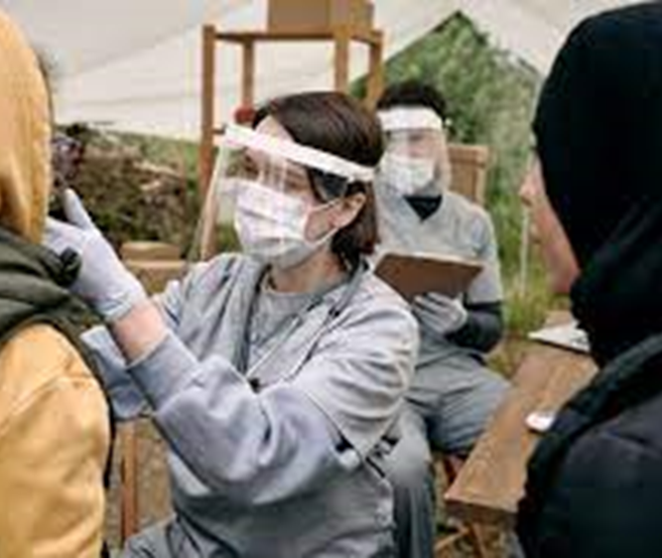



Complex Trauma
results from a single traumatic event that is devastating enough to have long-lasting effects.
Notes:
Traumatization occurs when internal and external resources are inadequate for coping.
Examples:
Mass casualty school shooting,
car accident with fatalities involved,
refugee dislocation.
Characteristics:
Perpetual mourning or depression,
chronic pain,
concentration problems,
sleep disturbances,
irritability.

Slide 12




Vicarious/Secondary Trauma & Compassion Fatigue
Risk Factors for Compassion Fatigue:
  Being new to the field.
  History of personal trauma or burnout.
  Working long hours and/or having large caseloads.
  Having inadequate support systems.
Notes:
Signs of Compassion Fatigue:
Reduced sense of efficacy at work.
Concentration and focus problems.
Apathy and emotional numbness.
Isolation and withdrawal.
Exhaustion.
Jaded,
bitter pessimism.
Secretive addictions and self-medicating.

Slide 13
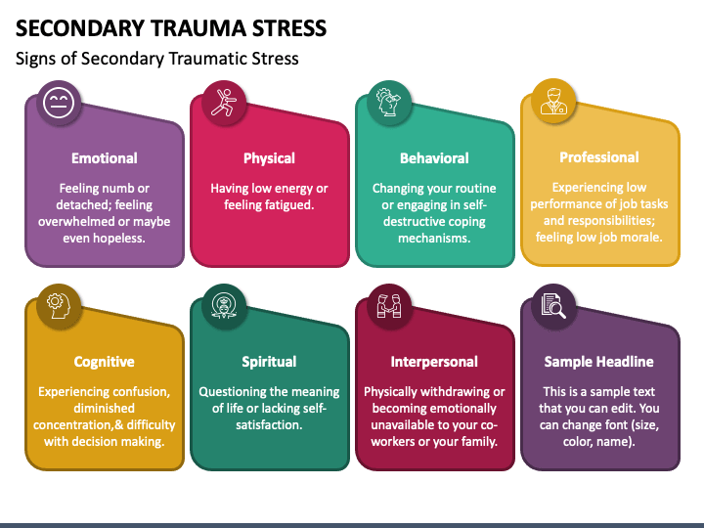


Slide 14
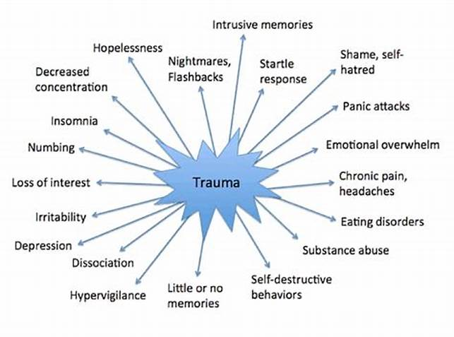
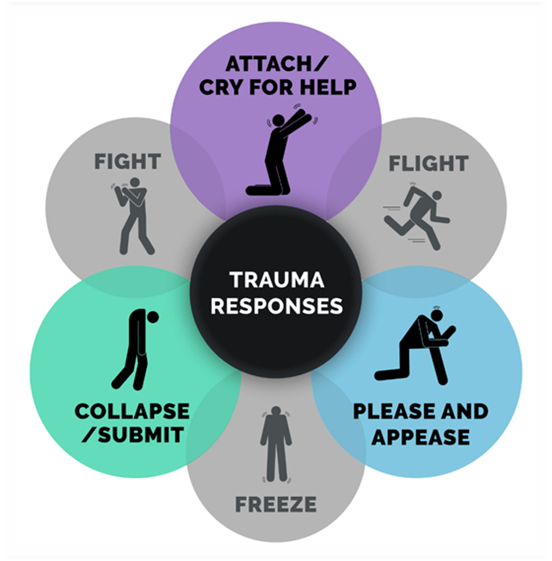
Effects of Trauma on Behavior
What type of trauma could be at play here?
What are some possible triggers?
They could be obvious or subtle.
How could you respond in a trauma-informed way?
Notes:
An example: You approach a client to join the group in an icebreaker to welcome someone new. It appears your client is finishing up an earlier task. You ask, “Want to play?” while touching their shoulder lightly. The person turns suddenly and strikes out at you, screaming, “Get away from me! Don’t touch me!”

Slide 15



What does trauma-informed care look like?
Explain why we need to perform a physical exam
  especially if it involves the breasts or genitals.
Why we’re asking sensitive questions.
Notes:
The first step is to recognize how common trauma is, and to understand that every patient may have experienced serious trauma. We don’t necessarily need to question people about their experiences; rather, we should just assume that they may have this history, and act accordingly.
We should explain why we need to perform a physical exam, especially if it involves the breasts or genitals.
Allow them to have a support person if they choose
Tell them that we will stop at any time, just say the word
We can respond with compassion and work with them, rather than attempting to force them or becoming annoyed

Slide 16
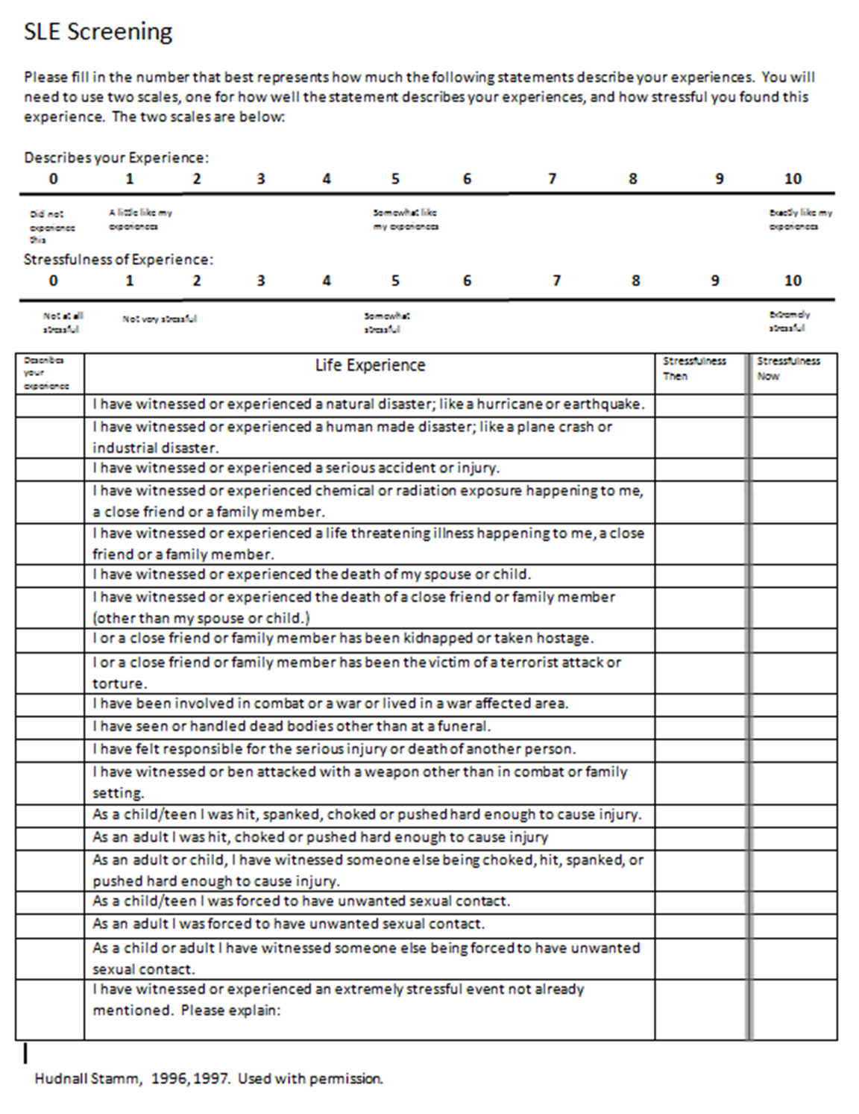
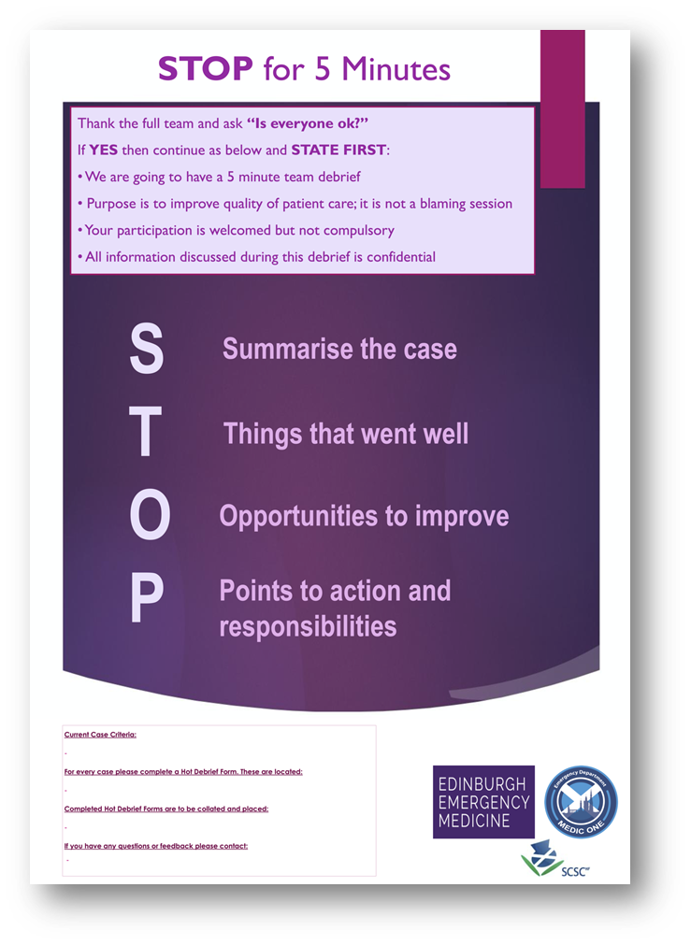

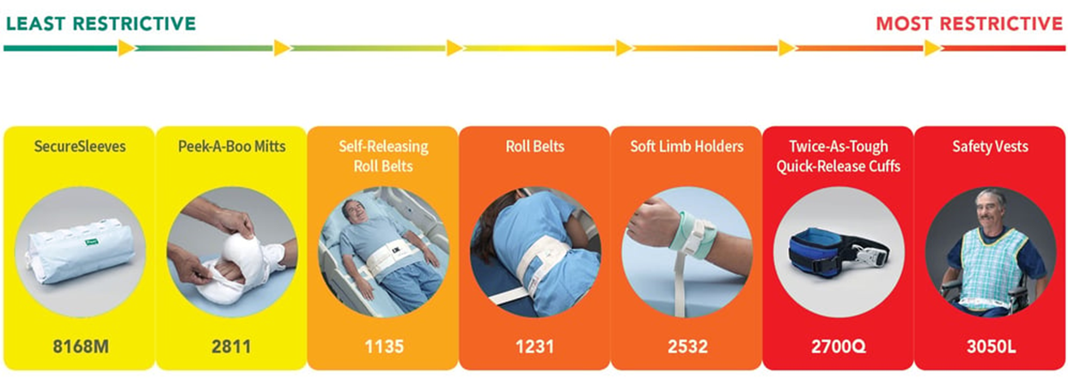

7 Tips for Preventing Re-Traumatization
Learn as much as you can.
Grow your skill of attunement.
Look for the causes of behaviors
Use person-centered, strength-based thinking and language.
Provide consistency, predictability, and choice-making opportunities.
Always weigh the physiological, psychological, and social risks of any physical interventions.
Debrief.
Notes:
1. Collect data and screen for trauma histories. (Stressful Life Events Screening Questionnaire (SLESQ)
The most important domains to screen among individuals with trauma histories include:
Trauma-related symptoms.
Depressive or dissociative symptoms,
sleep disturbances, and intrusive experiences.
The Stressful Life Events Screening Questionnaire (SLESQ) is a 13-item self-report measure for non-treatment seeking samples that assesses lifetime exposure to traumatic events. Eleven specific and two general categories of events, such as a life-threatening accident, physical and sexual abuse, witness to another person being killed or assaulted, are examined. For each event, respondents are asked to indicate whether the event occurred ("yes" or "no"), their age at time of the event, as well as other specific items related to the event, such as the frequency, duration, whether anyone died, or was hospitalization, etc. The SLESQ is recommended for research and general screening purposes, and is available in English and Spanish.
2. Grow your skill of attunement.
That is, develop your capacity and the capacity of staff and clients to accurately read each other’s cues and respond appropriately.
3. Look for the causes of behaviors.
Seek to understand the function of behaviors and what the behaviors are communicating.
What you might view as a frustrating behavior may actually be a coping mechanism attempt.
If your response is not trauma-informed, it could play right into causing the individual to feel less safe and even more disconnected.
4. Use person-centered, strength based thinking and language- Help to shift from a deficit-based mindset to a strength-based mindset.
Instead of looking at how a person is “a victim” or “damaged,” we can view them as a survivor.
Focus on what they can do, and not on what they cannot do.
5. Provide consistency, predictability, and choice-making opportunities.
Meet the person where they are, in a way they understand.
Consistency and predictability provide feelings of safety for the individual, helping to reduce anxiety.
And by providing choice-making opportunities, you allow that person to have control.
All of this can go a long way to empower the person.
6. Always weigh the physiological, psychological, and social risks of any physical interventions. Be sure to choose the least-restrictive option possible in every situation.
7. Debrief. Prioritize debriefing after any crisis.
This will help you find patterns and triggers—and prevent crises from reoccurring.
It will also help you help the person foster resilience and develop successful coping skills.

Slide 17
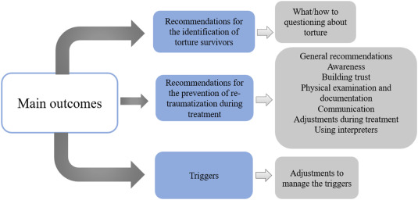
Summary
https://www.sciencedirect.com/science/article/pii/S0277953623001326
Notes:
Trauma-Informed Care: In trauma-informed settings, trustworthiness and transparency are crucial for building relationships with clients and staff, ensuring that all actions are conducted with openness and honesty.
Trauma is the emotional response to a time-based event that leads to an intense fear of your own or a loved one’s death, injury, or serious illness.
You can still have trauma even if it happened to someone else.

Slide 18


A trauma-informed perspective asks
“What happened to you?”
Instead of “What’s wrong with you?”
Notes:
Experiencing a trauma can change the way a person perceives the world.
Whether trauma is caused by a single event such as a natural disaster, or by repeated or prolonged exposure to abuse, an individual’s thoughts, feelings, and behaviors are filtered through their experience and perspective.

Slide 19
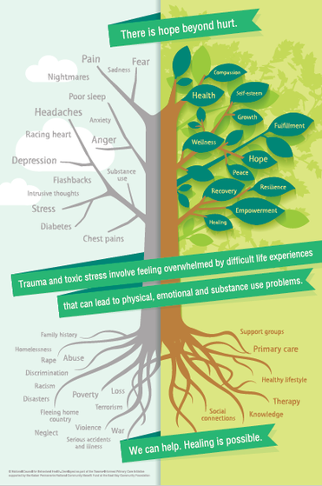
There is Hope Beyond Hurt
https://resilientlehighvalley.org/profession/trauma-informed-care-poster/

Slide 20


Slide 21
Resources:
Trauma-Informed Care Resource Guide (2017) https://www.crisisprevention.com/Blog/November-2018/Trauma-Informed-Care
Trauma-Informed Care Implementation Resource Center https://www.traumainformedcare.chcs.org/ Videos produced by FreshFly and Ruben de Luna Creative. https://youtu.be/KkeLz-fI0Mo
Video project on Principles of Trauma Informed Recovery, https://vimeo.com/107478500
National Council for Behavioral Health, Shareables and Infographics, https://www.thenationalcouncil.org/consulting-best-practices/national-council-shareables/

Slide 22
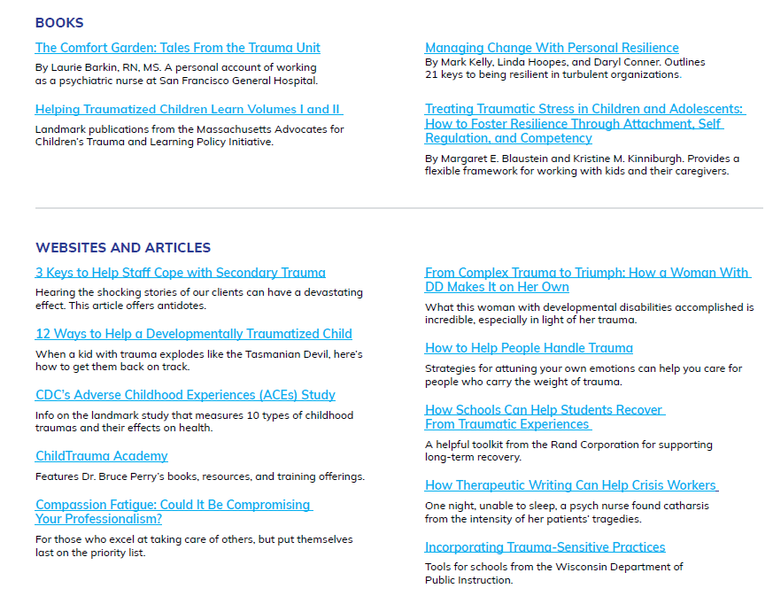

Slide 23


Slide 24
Adverse Childhood Events
Patti Scott, DNP, APRN, NNP-BC, C-NPT

Slide 25
Adverse Childhood Experiences (ACEs)
These are potentially traumatic events that occur during our childhood (birth to 17 years)
  Experiencing violence, abuse, or neglect
  Witnessing violence in the home or community
  Having a family member attempt or die by suicide
Notes:
About 64% of adults in the US report experiencing at least one type of ACE before they turned 18 years of age. Nearly 1 in 6 (~17%) adults reported experiencing 4 or more types of ACEs.
Among high school students, the most common types of ACEs were emotional abuse, physical abuse, and living in a home affected by poor mental health or substance abuse.

Slide 26

ACEs
It also includes situations in a child’s environment that can weaken their sense of safety, stability, or bonding. Examples include:
  Substance use
  Mental health
  Instability due to parental separation or family members being incarcerated
  Home and/or food instability
  Discrimination

Slide 27
Who is most at risk for ACEs?
Females
Non-Hispanic American Indian
Alaskan Native adults
Unemployed adults or adults who are unable to work

Slide 28

Effects
Toxic stress from ACEs can negatively affect:
  Brain development
  Immune function
  Response to stress
Notes:
Toxic stress – extended or prolonged stress
Negatively affect brain development – attention, decision-making, learning

Slide 29
Outcomes
Can have lasting effects on health/well-being and life opportunities:
  Limits education opportunities
  Limits job potential
  Increases the risk of injury, STDs, and involvement in sex trafficking
  Increases the risk of teen pregnancy, pregnancy complications, and even fetal death
  Increases the risk for cancer, diabetes, heart disease, suicide
Notes:
There is some evidence that if we could prevent ACEs, we might potentially reduce many health conditions – heart disease, depression, suicide, prescription pain medication misuse, persistent feelings of sadness or hopelessness
Economic burden is real – ACE—related health consequences cost an estimated $748 billion annually in Bermuda, Canada, and the US.

Slide 30
Language Matters

Slide 31

Stigma…
Discriminates against people and marginalizes them
Creates barriers to accessing what is needed to survive and thrive – healthcare, housing, income, and social services
Can lead to anxiety, isolation and loss of self-love
Strips individuals of their dignity and autonomy
  If you are told over and over that you are worthless, what will you begin to think about yourself?

Slide 32
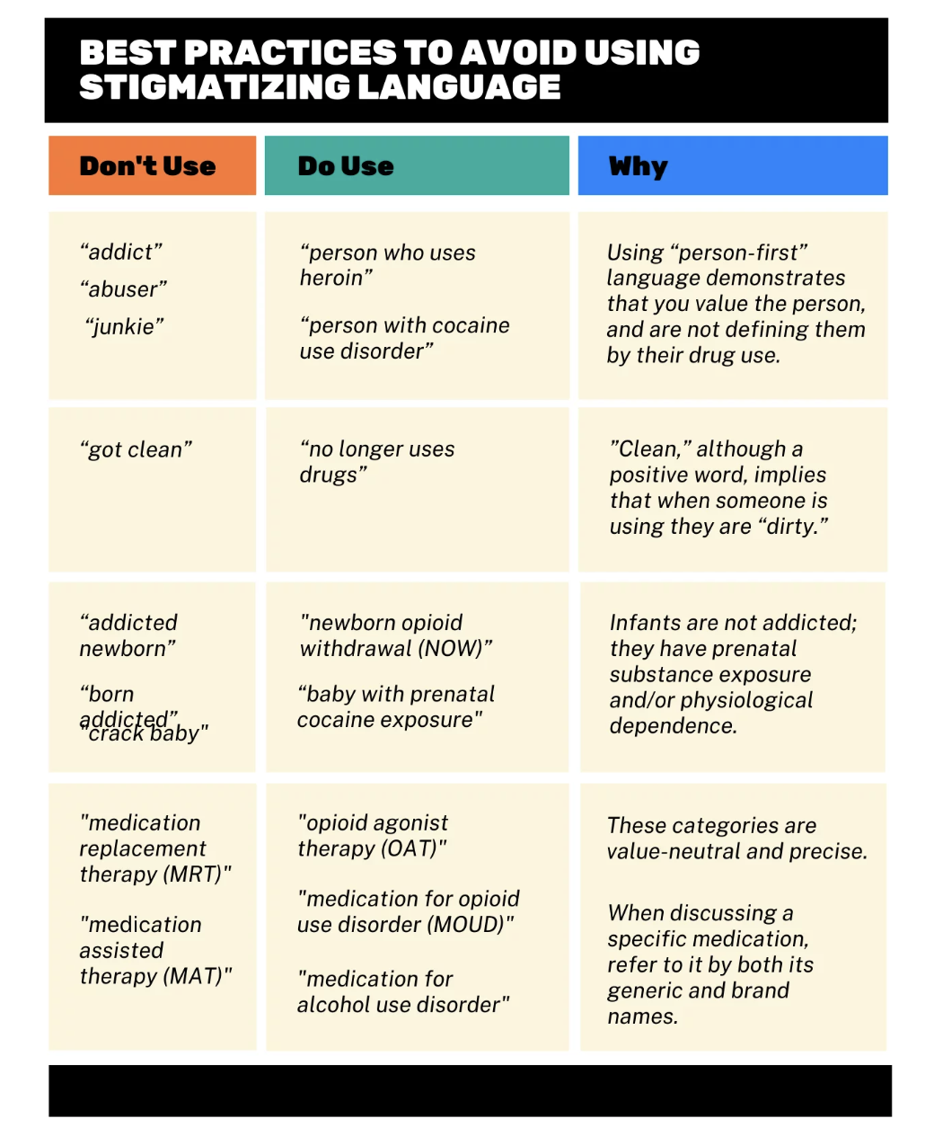
Pregnancy and Substance Use: A Harm Reduction Toolkit, Not Dated
National Harm Reduction Coalition & The Academy of Perinatal Harm Reduction

Slide 33
Unconditional Positive Regard
Accept and value people for who they are, irrespective of their behavior or choices
Care and accept without judgement, criticism, or evaluation
Assumes that people are inherently good
You want what is best for them
You believe they are competent and capable of choosing what is right for them based on their unique circumstances
You respect their right to make important decisions about their body and their health
You talk to the whole person, not just their substance use/infection/circumstances
Notes:
Developed by humanist psychologist Carl Rogers

Slide 34
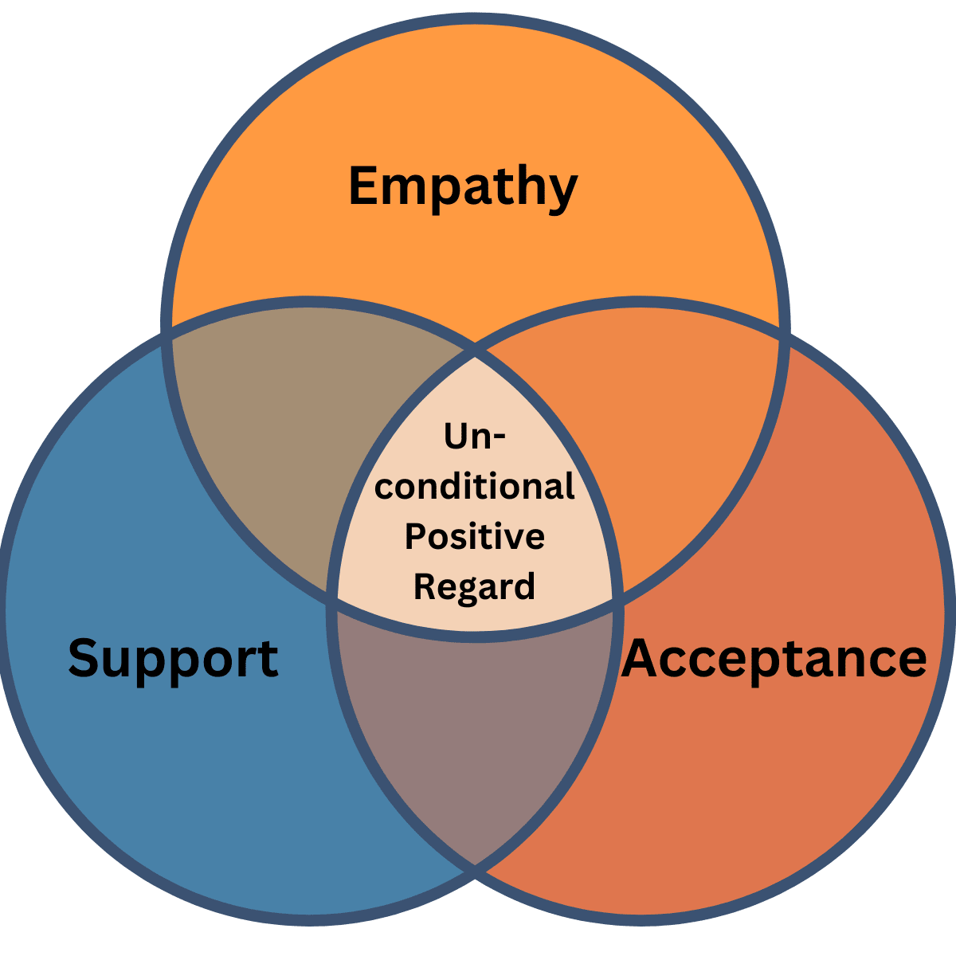
https://www.explorepsychology.com/the-power-of-unconditional-positive-regard/
Notes:
Empathy – offering emotional support – understanding how another person feels
Support – asking questions, listening, and then providing validation and providing the type of support that that person needs at that time and in that situation
Acceptable – embracing thoughts, emotions, and other internal experiences without judgement and without trying to change them
Where these 3 overlap is unconditional positive regard
Myth: unconditional positive regard means people can do whatever they want without consequences
Truth: Unconditional positive regard means accountability without the threat of losing relationships

Slide 35
When people feel “positive regard”….
They feel safer discussing the choices they are making
They know that even if they make a mistake, they will be supported
Helps them make choices that are different from the ones they have made before

Slide 36
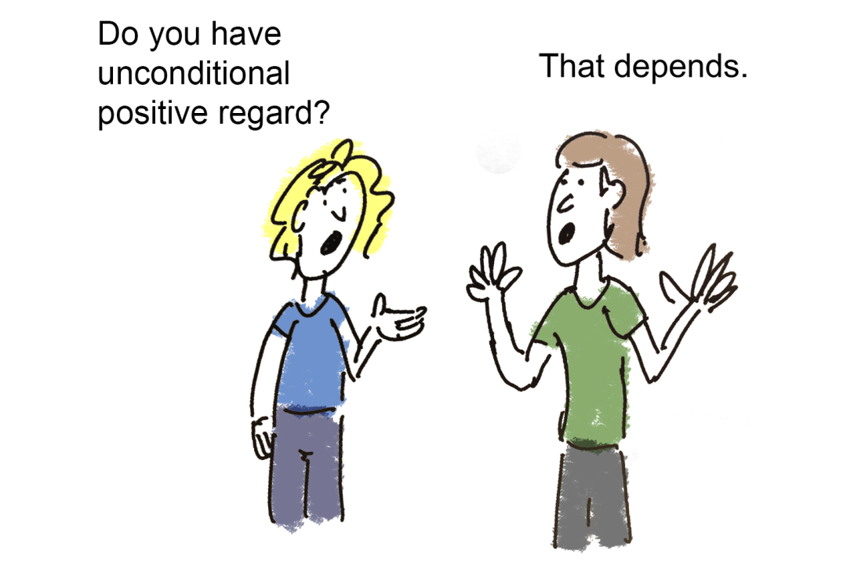
https://www.linkedin.com/pulse/therapists-corner-what-does-unconditional-positive-regard-chua

Slide 37
Motivational Interviewing
A tool to help with tough conversations
Requires us to have empathy, self-awareness, and the ability to partner with someone in your care
Ask questions – and then LISTEN to the answers
Use first-person language

Slide 38
Examples of Motivational Interviewing
Now that you are pregnant, you need to stop smoking.
What do you think about your smoking now that you are pregnant?
If you loved your children, you’d stop using.
I know you love your children. What can we do to help you parent them the way that you want to?
You’ll probably lose custody of this baby too.
What was it like when you lost your child?

Slide 39
Motivation Interview Methods
Ask – permission – “Can we talk about….”
open question – “What do you think about….”
closed question – “Would you want to…..”
Tell – education – “We know that….”
information – “Some of the choices are…..”
recommendations – “You might want to…..”
Listen – appreciate – “You know what you…..”
reflect – “You want to, but……”
summarize – “So your plan is…..”
Notes:
Sub

Slide 40
Resources
Centers for Disease Control (October, 2024). Adverse Childhood Experiences (ACEs)
https://www.cdc.gov/aces/about/index.html
Pregnancy and Substance Use: A Harm Reduction Toolkit, Not Dated
National Harm Reduction Coalition & The Academy of Perinatal Harm Reduction
https://www.linkedin.com/pulse/therapists-corner-what-does-unconditional-positive-regard-chua
https://www.explorepsychology.com/the-power-of-unconditional-positive-regard/

Slide 41
Having Difficult Conversations:
Navigating Sensitive Situations with Compassion and Clarity
Danielle Tate, MD

Slide 42
Objectives
Understand the importance of effective communication in obstetric care
Understand the unique emotional challenges surrounding the neonate
Learn strategies to facilitate effective, compassionate communication
Explore approaches to delivering bad news
Discuss supporting families through grief and uncertainty
Highlight team-based communication best practices
Identify common difficult conversations in OB
Apply strategies for managing these conversations with empathy and professionalism
Improve patient experience and reduce provider stress

Slide 43
The Obstetric Patient:
Why These Conversations Matter
High Emotional Stakes: Pregnancy, Birth, Loss
Impact on Patient Trust and Satisfaction
Legal and Ethical Implications
Provider Burnout and Emotional Toll

Slide 44
The Neonate Patient:
Why These Conversations Are Hard
Fragile Neonatal Conditions
High Parental Expectations and Emotions
Complex Medical Uncertainty
Moral Distress for Providers
Potential Long-term Implications

Slide 45
Common Difficult Conversations in Obstetrics
Perinatal Loss or Stillbirth
Fetal Anomalies and Poor Prognoses
Maternal Health Risks (e.g., Preeclampsia, Cardiac Disease)
Termination Discussions
Consent for High-risk Procedures
Conflict with Patient/family Expectations

Slide 46
Common Scenarios for the Infant
Poor Prognosis or Change in Clinical Status
Withdrawing or Withholding Life-sustaining Treatment
Breaking Bad News after a Code event or Surgery
Discussing Genetic or Neurologic Abnormalities
End-of-life Care Planning

Slide 47
Core Principles of Difficult Conversations
Prepare in Advance: Know the case and Anticipate Questions
Be Present: Physically and Emotionally available
Use Clear, Compassionate Language: Avoid jargon
Create a Private, Calm Environment
Empathy First: Acknowledge Emotions and Allow Space for Silence
Validate Feelings without False Reassurance
Support Decisions: Offer Guidance without Coercion

Slide 48
The SPIKES Framework for
Delivering Bad News
S – Setting up the Conversation
P – Perception: Assess Understanding
I – Invitation: Ask what they want to know
K – Knowledge: Share information Clearly and
Compassionately
E – Empathy/Emotions: Respond to emotions with
Empathy
S – Strategy and Summary: Outline Next Steps

Slide 49
Your Behavior: E.M.P.A.T.H.Y
Eye contact
Muscle of facial expression
Posture
Affect
Tone of voice
Hearing the whole patient
Your response
Academic Medicine 2014;vol 89 (8): 1108-1112

Slide 50
Language Tips – What to Say / Avoid
Say
Avoid
“I’m here with you.”
“This must be incredibly hard.”
“Let’s talk about what this means for you and your baby.”
“At least…”
“Everything happens for a reason.”
Medical jargon

Slide 51
Their Emotion: Articulating Empathy
Tool | Example | Notes
Naming (1) | “It sounds/looks like you are scared / sad / frustrated” | Naming the emotion will usually decrease the intensity of emotion
Understanding (<5) | “This helps me understand what you are thinking” | Use to convey acknowledgement while avoiding implications that you understand “everything”
Respecting (1-2) | “I can see you have really been trying to follow our instructions” | Give the patient/family credit for what they have done, praise is a motivator
Supporting (1-2) | “I will do my best to make sure you have what you need” | Commit 100% of what you can commit to without committing to things beyond your control
Exploring (∞) | “Could you say more about what you mean when you say that…” | Open-beginning statement with a focused end
Silence (∞) | “…” | Use invitational or compassionate silences as appropriate
www.vitaltalk.org/sites/default/files/quick-guides/NURSEforVitaltalkV1.0.pdf

Slide 52
Cultural and Emotional Sensitivity
Respect Spiritual and Cultural Beliefs
Use Interpreter Services when Needed
Recognize Different Grieving Styles
Validate Emotional Reactions, even if Intense

Slide 53
Supporting Families
Encourage Questions and Allow Silence
Provide Written Information if Appropriate
Offer Ongoing Updates and Access
Connect with Support: Counseling, Palliative Care, Chaplaincy

Slide 54

Provider Well-being
Acknowledge Moral Distress
Normalize Emotional Reactions
Create Safe Spaces to Debrief
Promote Peer Support and Wellness Initiatives

Slide 55
A case discussion

Slide 56
Case Study Discussion
37-year-old G4P0030 with PPROM at 22.0 weeks. History of cervical insufficiency with three previous losses between 16 and 20 weeks. Cerclage in place.
Neonatologist
Obstetric Nurse
Multidisciplinary Team
Discussion
Obstetrician
Perinatologist

Slide 57
Case Study Discussion
The patient subsequently delivers at 22.5 weeks via urgent C-section following preterm labor. Full resuscitative efforts are undertaken by the Neonatal ICU team in the delivery room and the neonatal is transferred the NICU on full support.

Slide 58
Case Study Discussion…Remixed
24-year-old G1P0 with preeclampsia with severe features at 24.0 weeks. Fetus with severe IUGR with abnormal Doppler studies (reversed flow) an an estimated weight of 298 grams.
Neonatologist
Obstetric Nurse
Multidisciplinary Team
Discussion
Obstetrician
Perinatologist

Slide 59
Conclusion
Honesty, Compassion, and Effective communication are the key components to having a successful difficult discussion
Effective Communication is a Skill to be Learned…Not Practiced
Effective Communication is an Act of Compassion
Families remember How We make Them Feel
Practice, Teamwork, and Empathy make a Difference

Slide 60


Slide 61
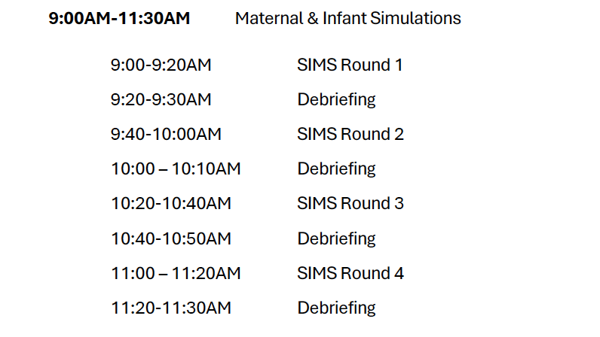
Next up… Simulations
Notes:
Group 1 through 4

Slide 62
Group Debrief

Slide 63
Mental Health Care for
Providers and the Care Team
Danielle Tate, MD

Slide 64

How do Various professions respond to traumatizing events???

Slide 65
When professionals experience extreme trauma—such as a police officer using a firearm—different fields have established protocols to support the individual's mental health, ensure safety, and manage operations.

Slide 66
Law Enforcement
Immediate Response:
Administrative leave, Investigation, Psychological Evaluation
Mental Health Support:
Peer Support Teams, Critical Incident Stress Debriefing (CISD), EAP
Long-Term Support:
Therapy clearance, Reassignment to Non-field Duties

Slide 67
Military
Immediate Response:
Combat Stress Control Assessment
Removal from Duty
Mental Health Support:
Behavioral Health Support, Mandatory Counseling
Long-Term Support:
VA Mental Health Services, Support Groups

Slide 68
Fire & EMS
Immediate Response:
Debrief after Traumatic Calls
Mental Health Support:
CISD sessions, Peer Support, Chaplains
Long-Term Support:
- Resilience Training, Therapy, Peer Networks

Slide 69
Aviation
Immediate Response:
Grounded for Evaluation, Formal Investigation
Mental Health Support:
- Peer Support Programs, Counseling
Long-Term Support:
Psychiatric Clearance, Therapy

Slide 70
Education
Immediate Response:
- Temporary Leave or School Closure
Mental Health Support:
- Crisis Response Teams, School Psychologists
Long-Term Support:
Trauma-informed Teaching, Therapy Support

Slide 71
Healthcare
Immediate Response:
Rest days, Risk Management Review
Mental Health Support:
M&M conferences, Peer support, EAP
Long-Term Support:
Resilience Training, Ongoing Therapy

Slide 72










Slide 73
Healthcare: The Reality
Immediate Response:
Rest days, Risk Management Review
Mental Health Support:
M&M conferences, Peer support, EAP
Long-Term Support:
Resilience Training, Ongoing Therapy

Slide 74
Why This Matters
High Rates of Burnout, Depression, and Anxiety among Providers
Exposure to Trauma and Emotional Strain
Direct Impact on Patient Care and Safety
COVID-19 Pandemic intensified Mental Health Challenges
Retention and Team Cohesion depend on Psychological Well-being
Importance of Early Identification and Supportive Environments for Patients and Colleagues

Slide 75
Data Snapshot
Burnout: 63% of Physicians report symptoms.
-AMA, 2023
Suicide Risk: Higher in Physicians, especially Female Physicians
1 in 3 Nurses consider leaving the Profession due to Stress

Slide 76
Mental Health Challenges in Healthcare
Long Hours and Shift Work
Emotional Exhaustion from Patient Care
Vicarious Trauma and Moral Distress
Stigma in Seeking Help

Slide 77
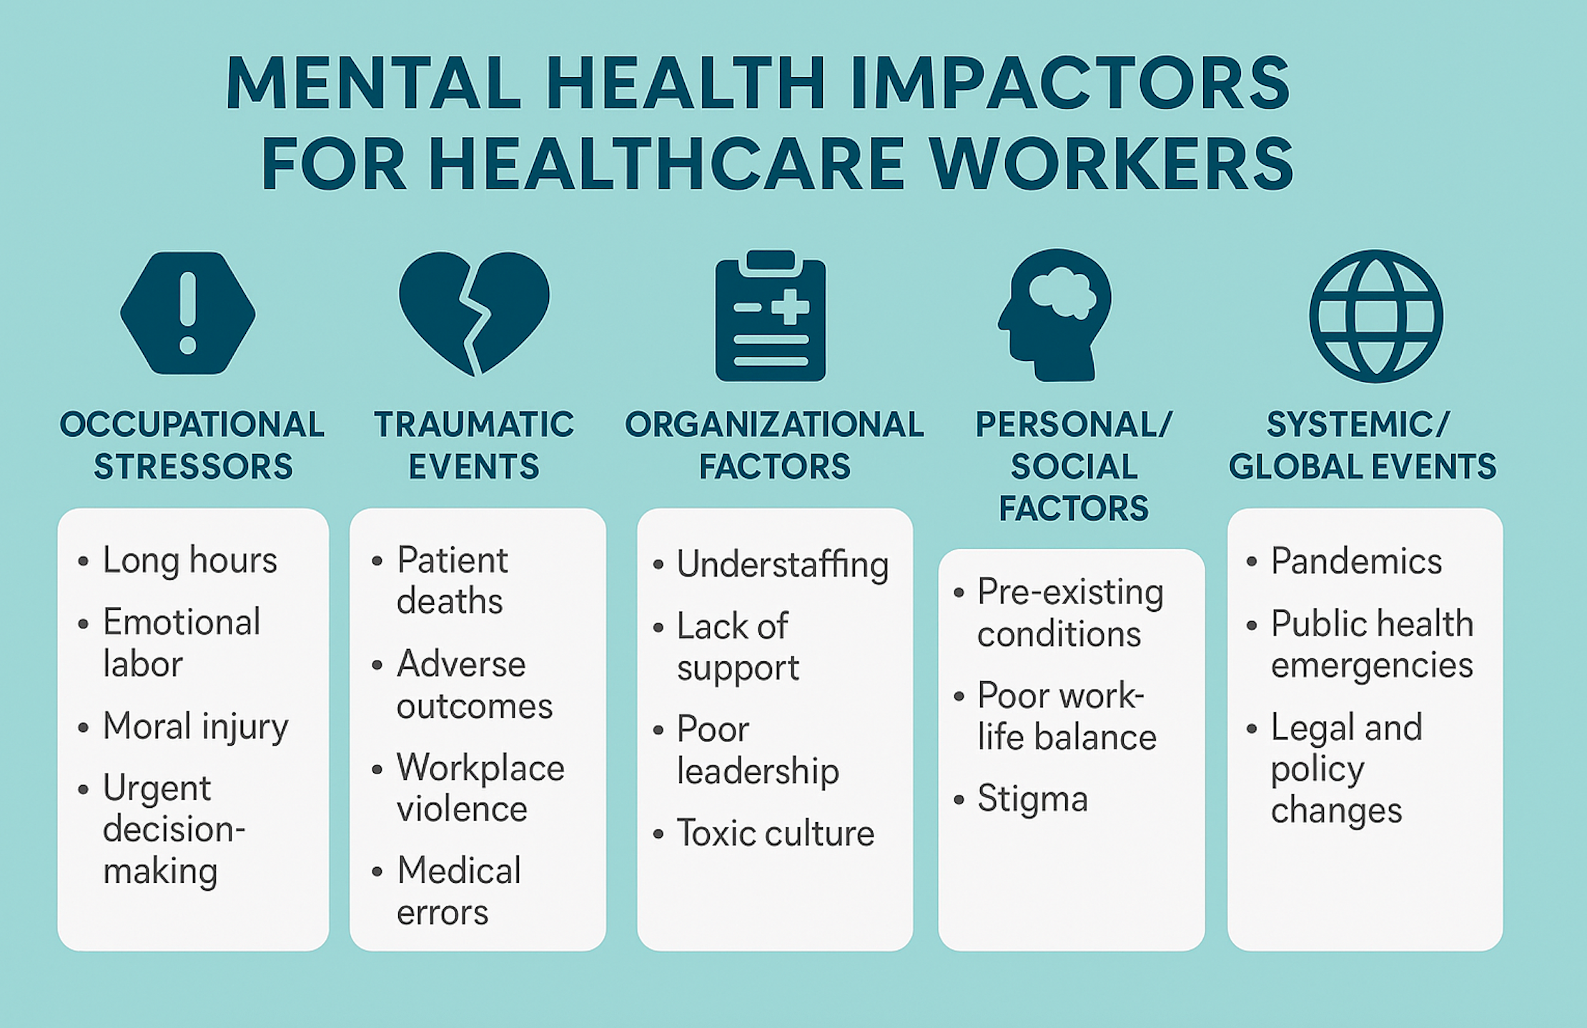
Secondary Traumatic Stress
National Academy of Medicine (NAM). Taking Action Against Clinician Burnout: A Systems Approach to Professional Well-Being. National Academies Press, 2019.https://doi.org/10.17226/25521

Slide 78
Recognizing Signs of Mental Health Struggles
Emotional Exhaustion
Detachment or Depersonalization
Reduced sense of Personal Accomplishment
Sleep Disturbances, Irritability, Absenteeism

Slide 79
Recognizing the Signs
Emotional
Irritability
Hopelessness
Physical
Fatigue
Insomnia
Detachment
Somatic Symptoms
Behavioral
Absenteeism
Reduced Performance
Isolation

Slide 80
Impact on Teams and Patient Care
Increased Medical Errors
Decreased Communication and Morale
High Turnover Rates
Lower Patient Satisfaction

Slide 81
Building a Culture of Mental Health
Normalize Conversations around Mental Health
Destigmatize Help-seeking
Train Leaders to Support Psychological Safety
Peer Support Programs and Buddy Systems

Slide 82
Organizational Support Strategies
Provide Access to Confidential Mental Health Services
Protected Time for Self-care and Breaks
Resiliency and Mindfulness Training
Debriefing after Critical Incidents

Slide 83
Organizational Support Strategies
Foster a Culture of Openness and Support
Implement Regular Wellness Check-ins
Encourage use of PTO and Ensure Manageable Workloads

Slide 84
Individual Strategies
Boundaries: Know Your Limits
Mindfulness and Stress Reduction Tools
Physical Health: Sleep, Nutrition, Activity
Professional Support: Therapy, Coaching

Slide 85
Individual Strategies
Self-awareness and Regular Self-check-ins
Seek Peer or Professional support when Needed
Establish Work-Life Harmony

Slide 86

Team-Based Interventions
Promote peer support Groups and Debriefing sessions
Encourage Team Communication and Collaboration
Celebrate Successes and Acknowledge Stressors Collectively

Slide 87

Role of Leadership
Model Healthy Behaviors and Work-life Balance
Be Accessible and Approachable
Provide training in Trauma-informed care and Resilience
Recognize and Address Signs of Staff Distress

Slide 88

Tools and Resources
Employee Assistance Programs (EAPs)
Online Counseling and Mental Health Apps
Support Hotlines and Professional Organizations
Mental Health First Aid Training (MHFA

Slide 89
Tools and Resources
Employee Assistance Programs (EAPs)
Online Counseling and Mental Health Apps
Support Hotlines and Professional Organizations
Mental Health First Aid Training (MHFA)

Slide 90
MHFA Action Plan: ALGEE
A – Assess for risk of Suicide or Harm
L – Listen Non-judgmentally
G – Give Reassurance and Information
E – Encourage Appropriate Professional Help
E – Encourage Self-help and Support Strategies

Slide 91
MHFA: Recognizing Warning Signs
Changes in Behavior or Mood
Withdrawal or Isolation
Increased Errors or Absenteeism
Expressions of Hopelessness or Distress

Slide 92
MHFA: How to Approach a Colleague
Choose a Private, Calm Moment
Express Concern without Judgment
Use Open-ended Questions
Validate their Feelings and Experiences

Slide 93
MHFA: Immediate Action Steps
Ensure Safety if at Risk of Harm
Connect to Resources (EAP, crisis lines)
Stay with them if needed
Document and Follow Institutional Protocols
Check-In or Circle Back

Slide 94
MHFA: Boundaries and Limitations
Know Your Role: You are NOT a Therapist
Maintain Confidentiality (within limits)
Take Care of your Own Mental Health
Refer to Trained Professionals when necessary

Slide 95
Tools and Resources
National Physician Support Line
Headspace or Calm (some Hospitals offer subscriptions)
Local Mental Health Providers
Crisis Text Line (Text HOME to 741741)
National Suicide Prevention Lifeline: 988

Slide 96
Call to Action
Take one Step Today:
  Schedule a Check-in
  Share this Presentation
  Access a Mental Health Resource
Create Space in your Team for Open Dialogue
Advocate for Systems that Care for the Caregivers

Slide 97
Questions & Discussion
What are current barriers in your team?
What support would help you thrive?

Slide 98
Conclusion
Mental Health is Essential for Quality Patient Care
Support must be Continuous and Multifaceted
Together, we can create a Sustainable and Supportive Work Environment

Slide 99

Thank You

Slide 100

Post tEst & Evaluation
Please take a minute to complete the Post-SIMS Test & evaluation

