Slide 1
Implementing Count the Kicks to standardize fetal movement monitoring
Dr. Tiffany Gouch, PhD.
Nashville Count the Kicks Ambassador & Tennessee Consultant
Healthy Birth Day, Inc.
Nashville.Ambassador@countthekicks.org

Slide 2
National Stillbirth Numbers by Race
Chance of experiencing a stillbirth based on 2022 Data from the CDC
(CDC 2022 Vital Statistics, available on request)
1 in 177
U.S. pregnancies
5-year average (2018-2022)
1 in 97
1 in 100
1 in 139
Native Hawaiian or Other Pacific Islanders
Black Pregnancies
Indigenous Pregnancies
1 in 216
1 in 223
1 in 270
Hispanic Pregnancies
White Pregnancies
Asian Pregnancies
Notes:
Our organization is focused on stillbirth prevention, and we keep our eye on the national data, and the state data. In recent years we have noticed that while the overall rate is declining, disparities exist.
Tennesse specific data follows

Slide 3
Stillbirth Data in Tennessee
Notes:
Hybels
Please note that these numbers were collected from the CDC Wonder database and are based on the most recent 5 year average we have available, which is between 2017-2021
{Read each statistic in the slide.}

Slide 4
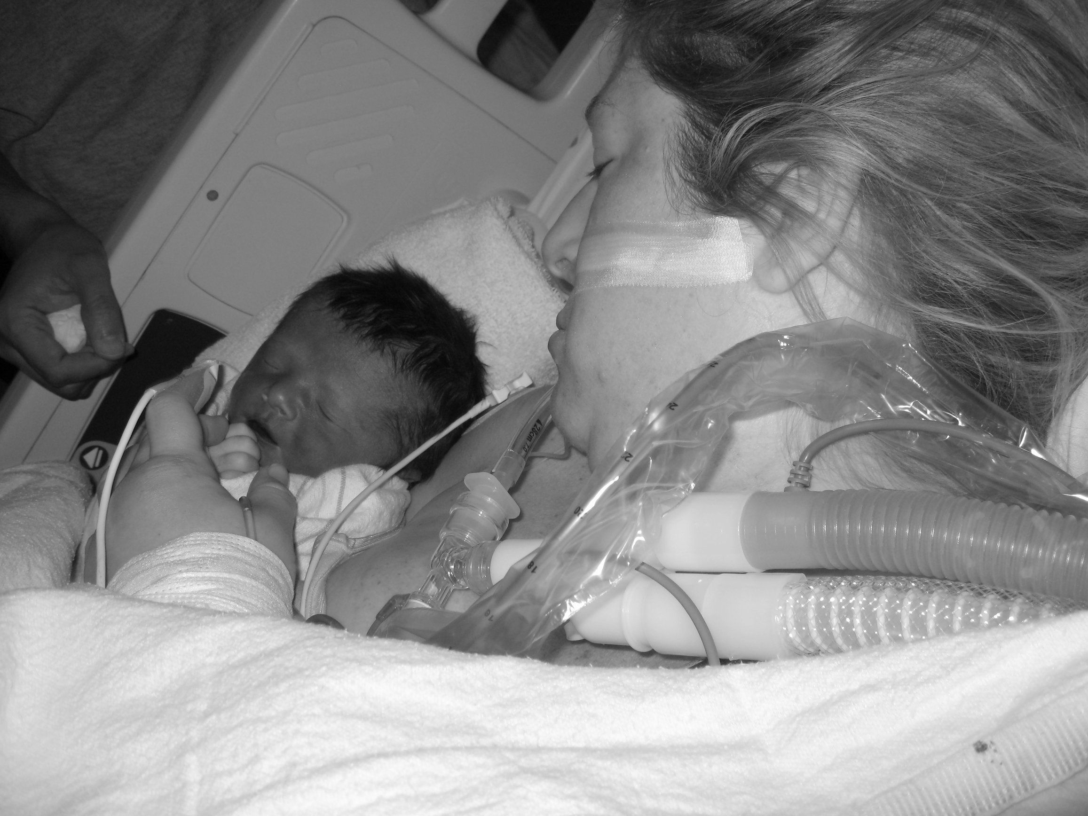
Stillbirth & Severe Maternal Morbidity
Stillbirth is a significant contributor to severe maternal morbidity (SMM)
Women who experience a stillbirth are four to five times more likely to die and 7 times more likely to experience SMM
These results indicated an increased risk of SMM among patients with stillbirth. Investigators concluded SMM risk is increased not only during the delivery hospitalization but also at any time during the prenatal period and up to 1 year following delivery. (AJOG,2024)
Pictured: Shawn Soumilas and her son, Zach – born still in 2010, used with permission
Notes:
Investigators have concluded SMM risk is increased not only during the delivery hospitalization but also at any time during the prenatal period and up to 1 year following delivery.
Our Arizona Ambassador Shawn Soumilas shares her story: The beautiful boy in the picture on the left is my son Zach who was stillborn at full term in 2010. Throughout my pregnancy with Zach, I raised numerous concerns that were consistently dismissed. Two days before my son's death, I reported to my provider that he wasn't moving as much. Despite this, I was assured that everything was okay and that he was simply settling down for birth. On July 3, 2010, Zach was stillborn due to a complete hidden placental abruption, I lost 3x my blood volume, and went into disseminated intravascular coagulation which led to multiple organ dysfunction. The picture on the right is the first time I held Zach in the ICU after coming out of surgery and my family being told that I had less than a 20% chance of survival. 14 years ago at this time I was planning Zach’s nursery and I should be planning an upcoming 14th birthday party. There will never be birthdays to celebrate with Zach and milestones like driving a car, graduating high school, or witnessing him start a family. I’m sharing my story with you today because while there's been progress in raising awareness about stillbirth, we must continue to amplify our voices if we truly want to tackle this crisis and prevent future generations from enduring such profound loss.
Association between stillbirth and severe maternal morbidity Nyarko, Samuel H. et al. American Journal of Obstetrics & Gynecology, Volume 230, Issue 3, 364.e1 - 364.e14

Slide 5
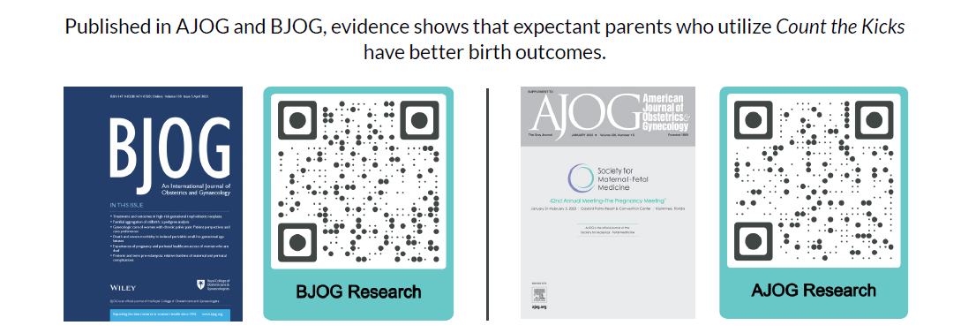
Count the Kicks Evidence
Notes:
The Iowa results were published in BJOG Winter 2023, and the data proves we matched Norway's success.
BJOG: An International Journal of Obstetrics and Gynaecology shows the stillbirth rate in Iowa went down one percent every three months for a decade, which is much faster than the U.S. population average.
That tells researchers that something was happening in Iowa from 2008-2018 that was not happening in the rest of the United States. Researchers are now calling for urgent action to address the stillbirth crisis in the U.S. because of the significant stillbirth rate reduction in Iowa.
You can read more about the research by clicking on the QR code on the slide, as well as research in AJOG that shows the additional benefits of Count the Kicks such as lowering anxiety and increased bonding with baby.

Slide 6
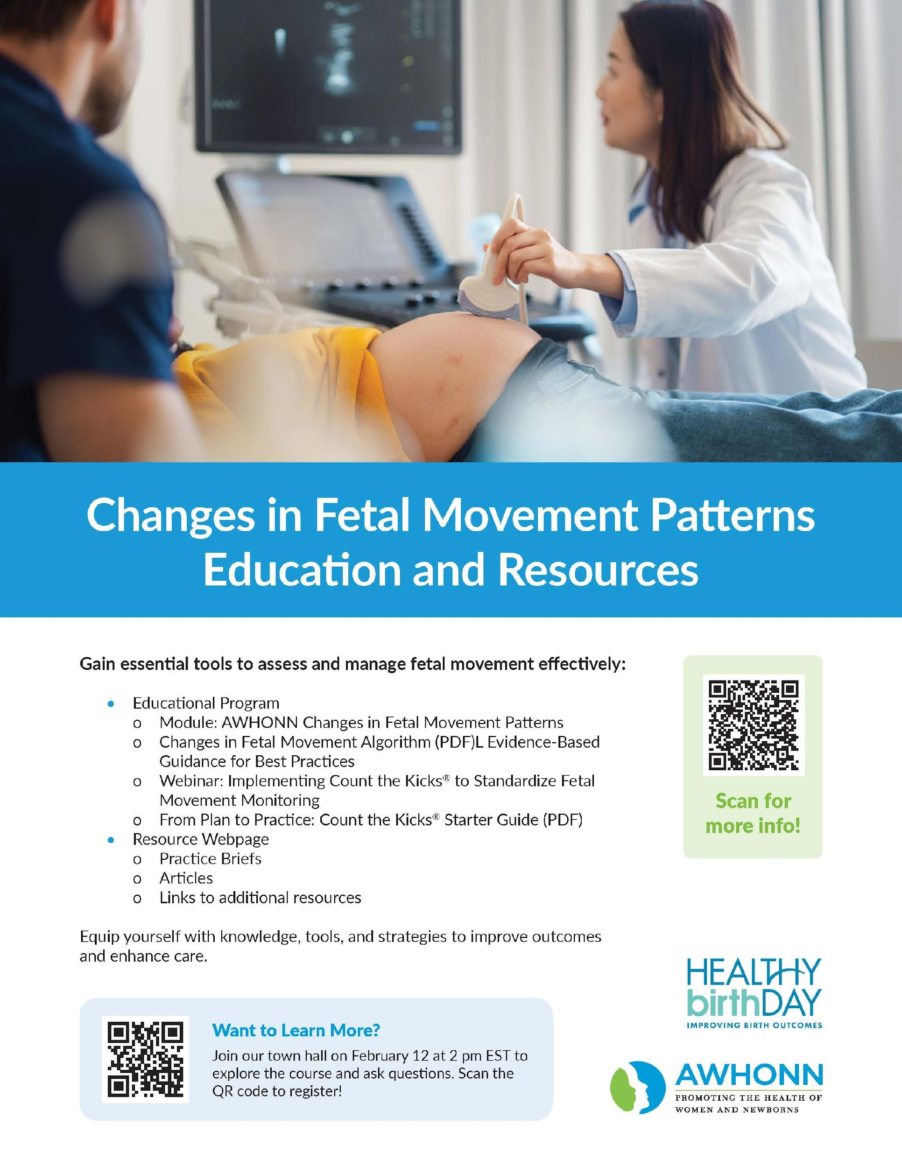
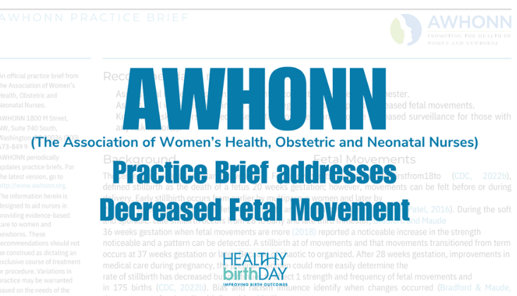
https://bit.ly/FetalMovement
Notes:
Over the last few years we have been working with the Association of Women’s Health, Obstetric and Neonatal Nurses – to create an algorithm of what clinics and health systems should do when a patient presents with a change in fetal movement – after rigrous lit reviews, research and testing the algorithm we are excited to share the results of our collaboration -
This module represent a significant advancement in how we educate clinicians and expectant parents on monitoring fetal movement, with the potential to save lives and improve outcomes systemically.
Through this partnership, we have integrated the latest evidence-based practices into the module, ensuring it reflects current research and clinical insights. These updates emphasize the importance of consistent monitoring of fetal movement patterns and equip healthcare providers with enhanced tools and resources to support their patients.
The module is designed to:
Improve education and training for clinicians, reinforcing best practices for monitoring fetal movement.
Empower expectant parents with actionable information to better understand and track their baby's movements.
Drive systemic change in clinical education and practice, with the goal of reducing stillbirth and saving lives.
. The module is available on Feb. 10th – but we encourage you to join us on Feb. 12th for a Townhall with AWHONN to learn more – --- the QR code on the flyer is for registration for the TownHall
I’d also like to share that last year AWHONN also released a Practice Brief on fetal movement monitoring and addressing it with patients in a standard way – please scan the larger QR code to read that.
Citation - Decreased Fetal Movement: AWHONN Practice Brief #20, Nursing for Women's Health, 2023, ISSN 1751-4851, https://doi.org/10.1016/j.nwh.2023.11.004. (https://www.sciencedirect.com/science/article/pii/S1751485123002489)

Slide 7
ACOG Guidance and Count the Kicks
The American College of Obstetricians and Gynecologists (ACOG) provides guidance on fetal movement monitoring, ACOG emphasizes:
Maternal Awareness of Fetal Movement: ACOG acknowledges the clinical significance of decreased fetal movement as a potential sign of fetal compromise. They encourage pregnant individuals to report any subjective decrease in fetal movement to their healthcare provider.
No Universal Standard for Kick Counts: ACOG does not specify a standardized method for counting fetal movements (e.g., "10 kicks in 2 hours"). Instead, it leaves the approach to individual patient needs and clinical judgment. They emphasize individualized care over routine or universal implementation of formal kick counting.
When to Use Fetal Movement Monitoring: ACOG highlights that monitoring fetal movements can be particularly beneficial in pregnancies at higher risk for complications (e.g., growth restriction, hypertension, diabetes).
Antepartum Fetal Surveillance: ACOG Practice Bulletin, Number 229. Obstet Gynecol. 2021 Jun 1;137(6):e116-e127. doi: 10.1097/AOG.0000000000004410. PMID: 34011889.
Notes:
We get asked a lot --- what does ACOG say about fetal movement monitoring –
I want to highlight that ACOG does in fact provide guidance on fetal movement monitoring – emphasizing the following ----
Read slide –
Antepartum Fetal Surveillance: ACOG Practice Bulletin, Number 229. Obstet Gynecol. 2021 Jun 1;137(6):e116-e127. doi: 10.1097/AOG.0000000000004410. PMID: 34011889.

Slide 8
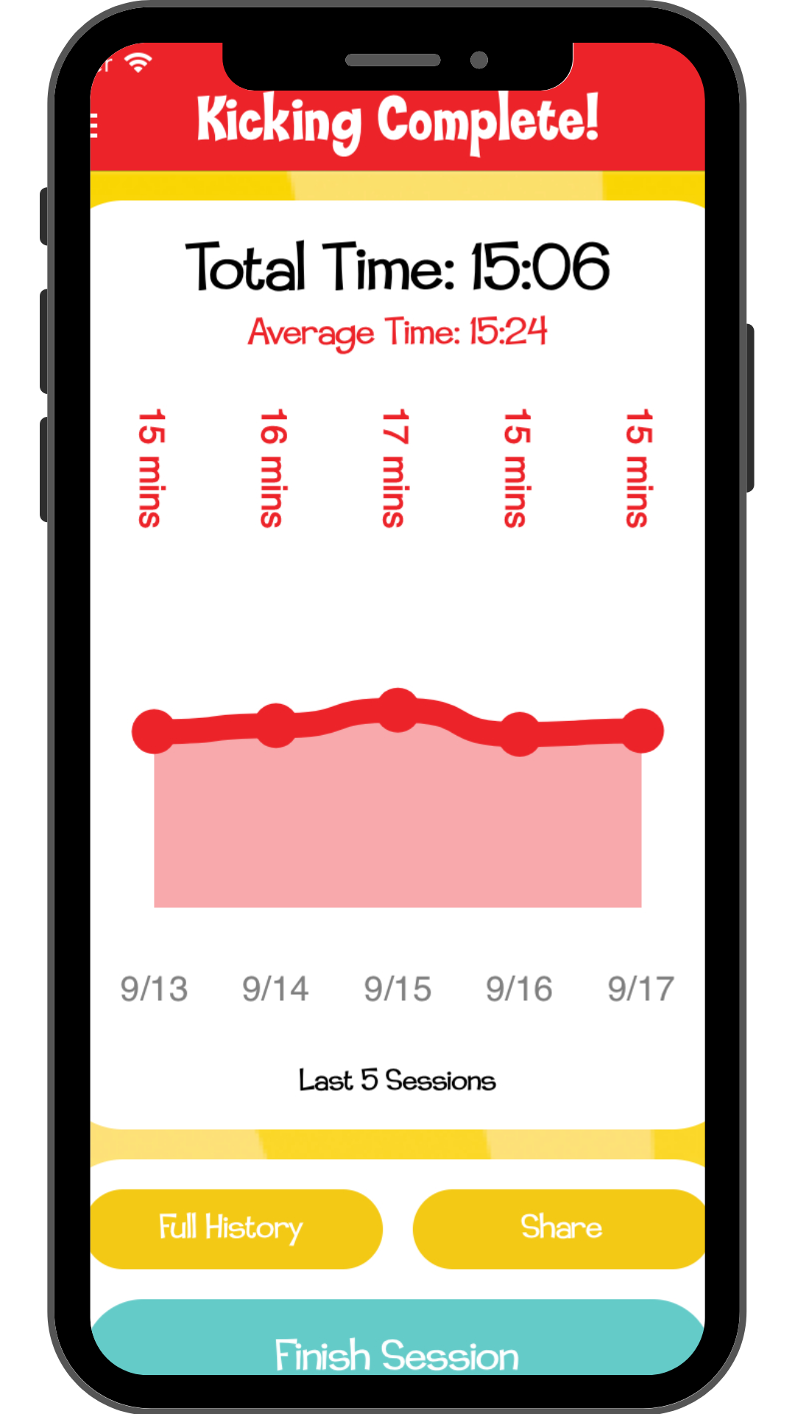
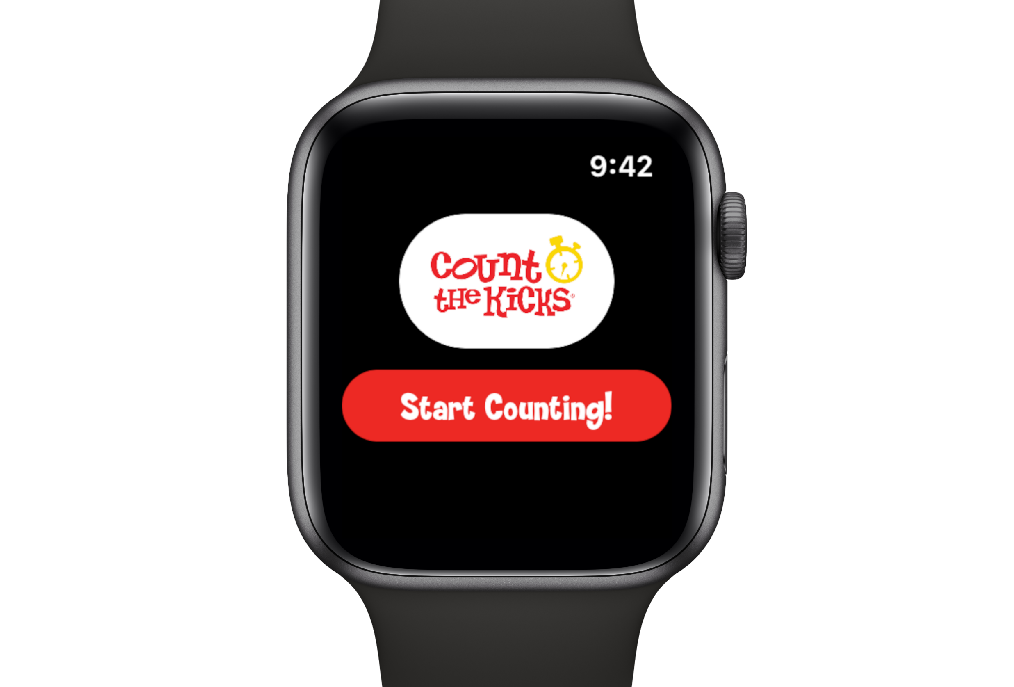
Count the Kicks App
Free and easy to use
Our FREE app is evidence-based and available in 20+ languages
Available for Apple and Android products
Set a daily reminder to Count the Kicks
Download history to share with their provider, family or friends via text or email
New features – Contraction Timer, OCR, Badges
Find free resources – FindHelp
We do not share or sell app user information.
Notes:
Here’s how it works. Every day, starting in the 3rd trimester, we want parents to count their baby’s movements. We want them to choose a time of day baby is most active and to continue counting around the same time each day. Encourage your patients to register so they can continue to get all their data history. When they sit down to focus on baby and they feel that first movement they hit that big teal foot you see there – once they start, a timer starts, they tap the footprint every time they feel baby move, push, kick….after they get to 10 movements the timer stops and the app asks the app user to rate the STRENGTH of their movements. Research shows that not only should we be paying attention to how long it takes baby to move but the strength of those movements. Once they rate the strength of those movements the app shows a graph – a visual representation of how baby has been moving, you can see it here in pink and red. It’s the trend line of how long it takes their baby to get to 10 movements. Think of it as a data download of their intuition – they can download that data and share with their provider or others.
Other features include the ability to count for single babies or twins, daily reminders and so much more – including a free resource where the app user can enter their zip code and find free or low cost resources near them – such as food banks and childcare assistance.
Finally, recently we just launched a contraction timer, OCR (a way to manually scan a paper chart into the app to remove the need for manual entry) and digital badges to encourage daily use on the app – we are continually listening to app users, providers and the like to know what’s important to them and updating accordingly.
Remember, if you or your patient does not have access to a mobile device, you can also do the same thing with our downloadable Count the Kicks chart by going to our website.

Slide 9
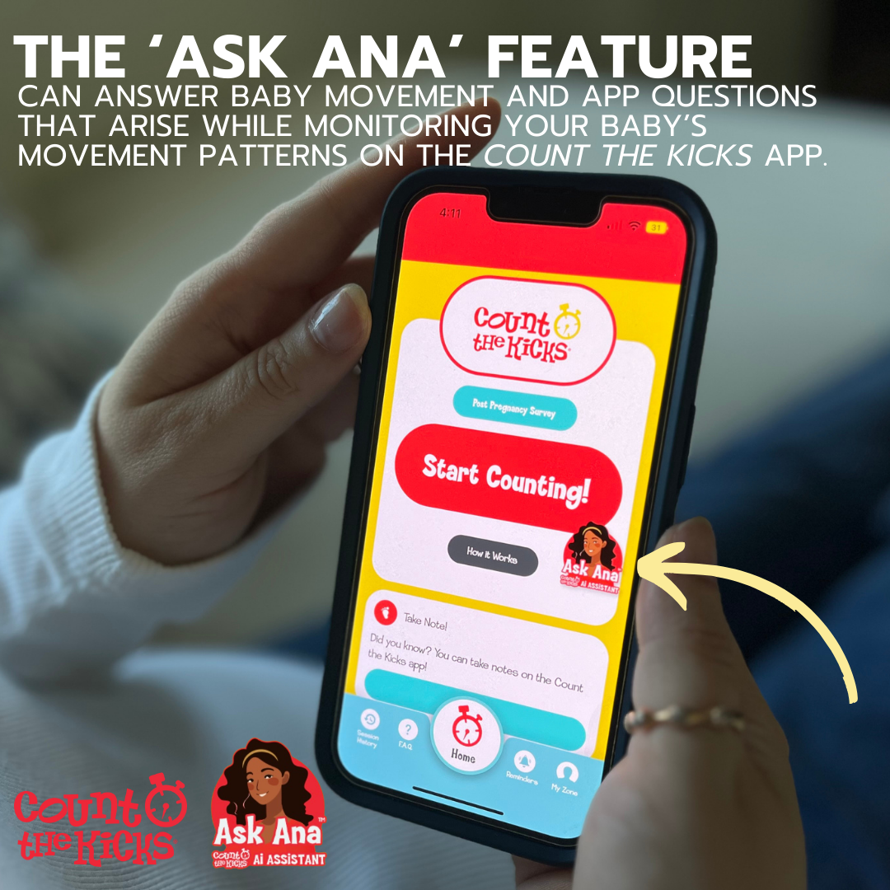
Ask Ana
AI Assistant
Free
Available in multiple languages
Access Ask Ana on our socials, website and the app
App users can ask questions about fetal movement and receive research-based answers.
Notes:
We are so excited to share a new feature on our app – we recently launched Ask Ana – which is an AI-generated assistant that provides instant responses to questions about baby’s movement, providing additional autonomy and advocacy for expectant parents using the free Count the Kicks app.
‘Ask Ana’ is a new feature that supports expectant parents throughout their pregnancy journey with instant, research-based answers to questions about pregnancy.
You can ask this feature on our website, social channels and of course our app –

Slide 10
Notes:
Let’s watch the impact this has -

Slide 11
Goal: Statewide Implementation
Notes:
As we work with the Tennessee Department of Health to save babies and prevent maternal morbidity and mortality, we want to cover the state of Tennessee with resources and support. Thank you for being a part of this work.

Slide 12
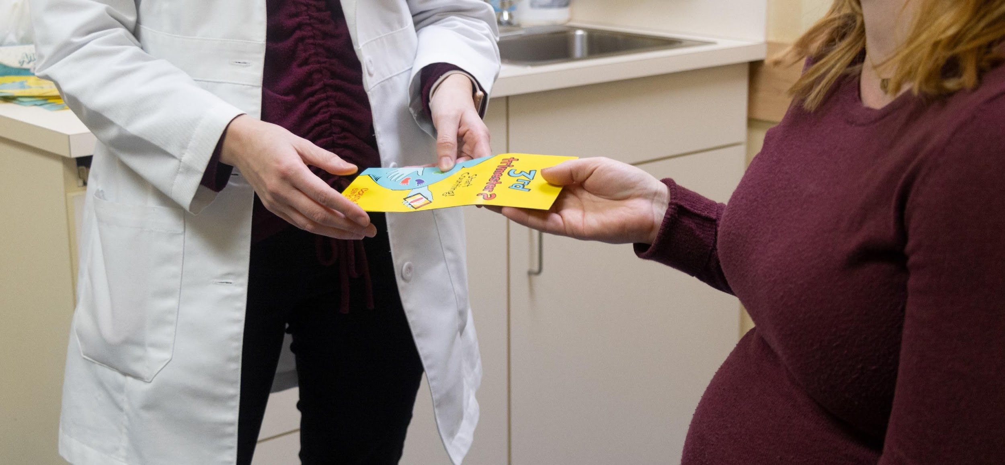
Educational Material
Tennessee
Patient Education Materials
Brochures, App Cards, Posters
Traditional & At-a-Glance
Fetal Movement Monitoring Wristbands
Magnets
Printable Kick-Counting Charts
Digital Resources in 9 languages
Free App in 20+ languages
Notes:
Here is a run down of materials that are available in Tennessee- and Dr. Gouch will have these at her table after the presentation and during the conference.

