Slide 1
SMFM/ACOG Obstetric Care Consensus
Safe Prevention of the Primary Cesarean
Society of Maternal Fetal Medicine, American College of Obstetricians and Gynecologists with the assistance of Aaron B. Caughey, MD, PhD; Alison G. Cahill, MD, MSCE; Jeanne-Marie Guise, MD, MPH; Dwight J. Rouse MD
Published in Am J Obstet Gynecol / March 2014

Slide 2
Objective
To create guidelines for obstetric practice which should safely lead to lower rates of primary cesarean delivery through updated guidance on labor management, fetal heart rate monitoring, and other inpatient and outpatient management decisions.
Notes:
The more you interrupt, the better

Slide 3
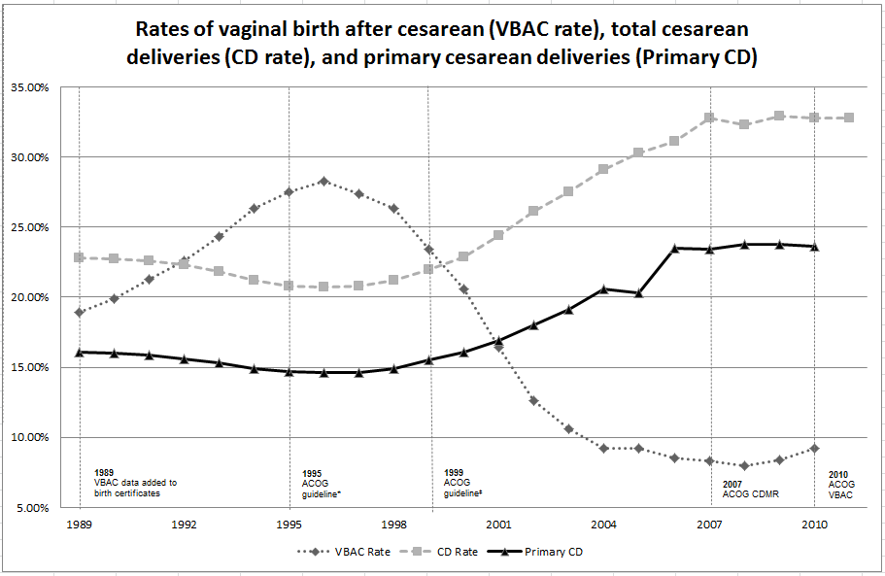
Background
Cesarean rates have increased appreciably without evidence of improved outcomes.
Hamilton BE, Martin JA, Ventura SJ. Births: Preliminary data for 2010. National vital statistics reports; vol 60 no 2. National Center for Health Statistics. 2011

Slide 4
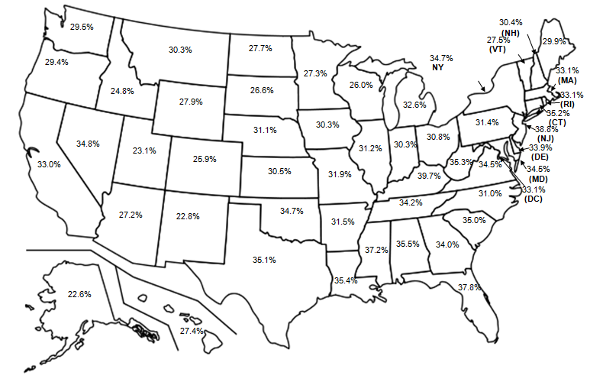
Background
There is great variation in cesarean rates around the country.

Slide 5
Background
While there are many cesarean indications, the majority are either arrest of labor or nonreassuring fetal heart rate.
Data from Barber EL, Lundsberg LS, Belanger K, Pettker CM, Funai EF, Illuzzi JL. Indications contributing to the increasing cesarean delivery rate. Obstet Gynecol 2011;118:29-38.

Slide 6
Recommendation #1
First Stage of Labor
A prolonged latent phase (greater than 20 hours in nulliparous women and greater than 14 hours in multiparous women) should NOT be an indication for cesarean delivery.
Grade recommendation = 1 B
  Strong recommendation
  Moderate quality evidence

Slide 7
Recommendation #2
First Stage of Labor
Slow but progressive labor in the first stage of labor rarely should be an indication for cesarean delivery.
Grade recommendation = 1 B
  Strong recommendation
  Moderate quality evidence

Slide 8
Recommendation #3
First Stage of Labor
As long as fetal and maternal status are reassuring, cervical dilation of 6 cm should be considered the threshold for the active phase in most laboring women. Thus, before 6 cm of dilation is achieved, standards of active phase progress should not be applied.
Grade recommendation = 1 B
  Strong recommendation
  Moderate quality evidence

Slide 9
Recommendation #4
First Stage of Labor
Cesarean delivery for active phase arrest in the first stage of labor should be reserved for women at or beyond 6 cm of dilation with ruptured membranes who fail to progress despite 4 hours of adequate uterine activity, or at least 6 hours of oxytocin administration with inadequate uterine activity and no cervical change.
Grade recommendation = 1 B
  Strong recommendation
  Moderate quality evidence

Slide 10
Recommendation #5
Second Stage of Labor
A specific absolute maximum length of the second stage of labor above which all women should be delivered operatively has not been identified.
Grade recommendation = 1 C
  Strong recommendation
  Low quality evidence

Slide 11
Recommendation #6
Second Stage of Labor
Before diagnosing arrest of labor in the second stage, if the maternal and fetal conditions permit, allow for the following:
  At least 2 hours of pushing in multiparous women (1B)
  At least 3 hours of pushing in nulliparous women (1B)
  Longer durations may be appropriate on an individualized basis (eg, with the use of epidural analgesia or with fetal malposition) as long as progress is being documented. (1B)
Grade recommendation = 1 B
  Strong recommendation
  Moderate quality evidence

Slide 12
Recommendation #7
Second Stage of Labor
Operative vaginal delivery in the second stage of labor should be considered a safe, acceptable alternative to cesarean delivery. Training in, and ongoing maintenance of, practical skills related to operative vaginal delivery should be encouraged.
Grade recommendation = 1 B
  Strong recommendation
  Moderate quality evidence

Slide 13
Recommendation #8
Second Stage of Labor
Manual rotation of the fetal occiput in the setting of fetal malposition in the second stage of labor is a reasonable intervention to consider before moving to operative vaginal delivery or cesarean delivery. In order to safely prevent cesarean deliveries in the setting of malposition, it is important to assess the fetal position throughout the second stage of labor.
Grade recommendation = 1 B
  Strong recommendation
  Moderate quality evidence

Slide 14
Recommendation #9
Fetal Heart Rate Monitoring
Amnioinfusion for repetitive variable fetal heart rate decelerations may safely reduce the rate of cesarean delivery.
Grade recommendation = 1 A
  Strong recommendation
  High quality evidence

Slide 15
Recommendation #10
Fetal Heart Rate Monitoring
Scalp stimulation can be used as a means of assessing fetal acid-base status when abnormal or indeterminate (formerly, nonreassuring) fetal heart patterns (eg, minimal variability) are present and is a safe alternative to cesarean delivery in this setting.
Grade recommendation = 1 C
  Strong recommendation
  Low quality evidence

Slide 16
Recommendation #11
Induction of Labor
Induction of labor generally should be performed based on maternal and fetal medical indications and after informed consent is obtained and documented. Inductions at 41 0/7 weeks of gestation and beyond should be performed to reduce the risk of cesarean delivery and the risk of perinatal morbidity and mortality
Grade recommendation = 1 A
  Strong recommendation
  Moderate quality evidence

Slide 17
Recommendation #12
Induction of Labor
Cervical ripening methods should be used when labor is induced in women with an unfavorable cervix.
Grade recommendation = 1 B
  Strong recommendation
  Moderate quality evidence

Slide 18
Recommendation #13
Induction of Labor
If the maternal and fetal status allow, cesarean deliveries for failed induction of labor in the latent phase can be avoided by allowing longer durations of the latent phase (up to 24 hours or longer) and requiring that oxytocin be administered for at least 12-18 hours after membrane rupture before deeming the induction a failure.
Grade recommendation = 1 B
  Strong recommendation
  Moderate quality evidence

Slide 19
Recommendation #14
Fetal Malpresentation
Fetal presentation should be assessed and documented beginning at 36 0/7 weeks of gestation to allow for external cephalic version (ECV) to be offered.
Grade recommendation = 1 C
  Strong recommendation
  Low quality evidence

Slide 20
Recommendation #16
Weight Gain in Pregnancy
Women should be counseled about the IOM maternal weight guidelines in an attempt to avoid excessive weight gain.
Grade recommendation = 1 B
  Strong recommendation
  Moderate quality evidence

Slide 21
Recommendation #17
Twin Gestations
Perinatal outcomes for twin gestations in which the first twin is in cephalic presentation are not improved by cesarean delivery. Thus, women with either cephalic/cephalic-presenting twins or cephalic/noncephalic presenting twins should be counseled to attempt vaginal delivery.
Grade recommendation = 1 B
  Strong recommendation
  Moderate quality evidence

Slide 22
Recommendation #16
Research & Policy
Individuals, organizations, and governing bodies should work to ensure that research is conducted to provide a better knowledge base to guide decisions regarding cesarean delivery and to encourage policy changes that safely lower the rate of primary cesarean delivery.
Grade recommendation = 1 C
  Strong recommendation
  Low quality evidence

Slide 23
Zhang Labor Curves
Labor curves published by Zhang, et al. are appreciably different from the Friedman curve.

Slide 24
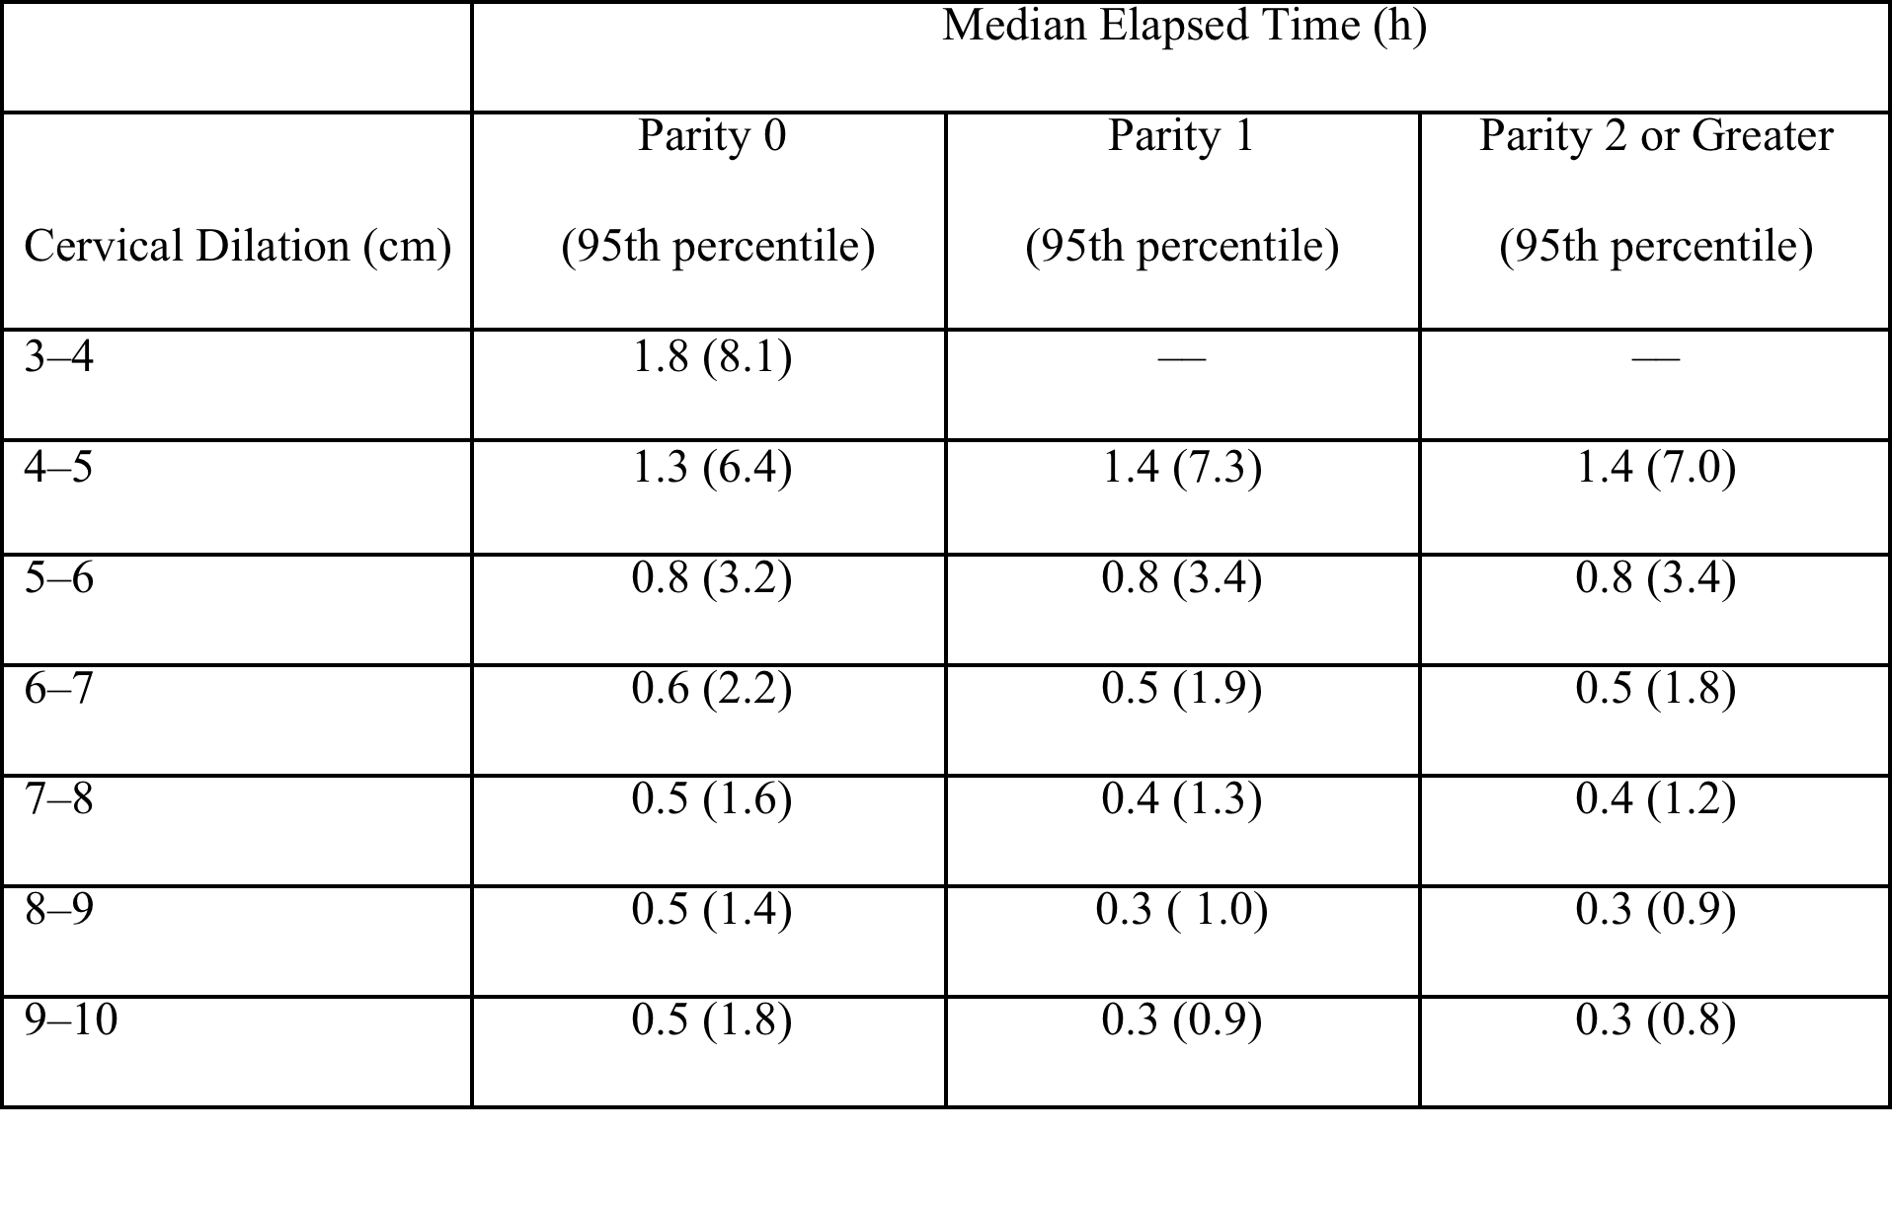
Zhang Labor curves
95%ile times are consistently longer than Friedman thresholds up to 7 cms.
Data from Zhang J, Landy HJ, Branch W, Burkman R, Haberman S, Gregory KD, et al. Contemporary patterns of spontaneous labor with normal neonatal outcomes. Obstet Gynecol 2010;116:1281–7.

Slide 25
Strength of Recommendations
Recommendations were ranked by strength in following categories:
Level 1
  Strong recommendation
Level 2
  Weak recommendation
Best practice
  Recommendation in which either: (i) there is enormous amount of indirect evidence that clearly justifies strong recommendation – direct evidence would be challenging, and inefficient use of time and resources, to bring together and carefully summarize; or (ii) recommendation to contrary would be unethical.
Notes:
Brian in particular

Slide 26
Quality of Evidence
The quality of scientific evidence were graded in the following categories:
Level A
  The recommendation is based on good and consistent scientific evidence.
Level B
  The recommendation is based on limited or inconsistent scientific evidence.
Level C
  The recommendation is based on expert opinion or consensus.
Notes:
Brian in particular

Slide 27
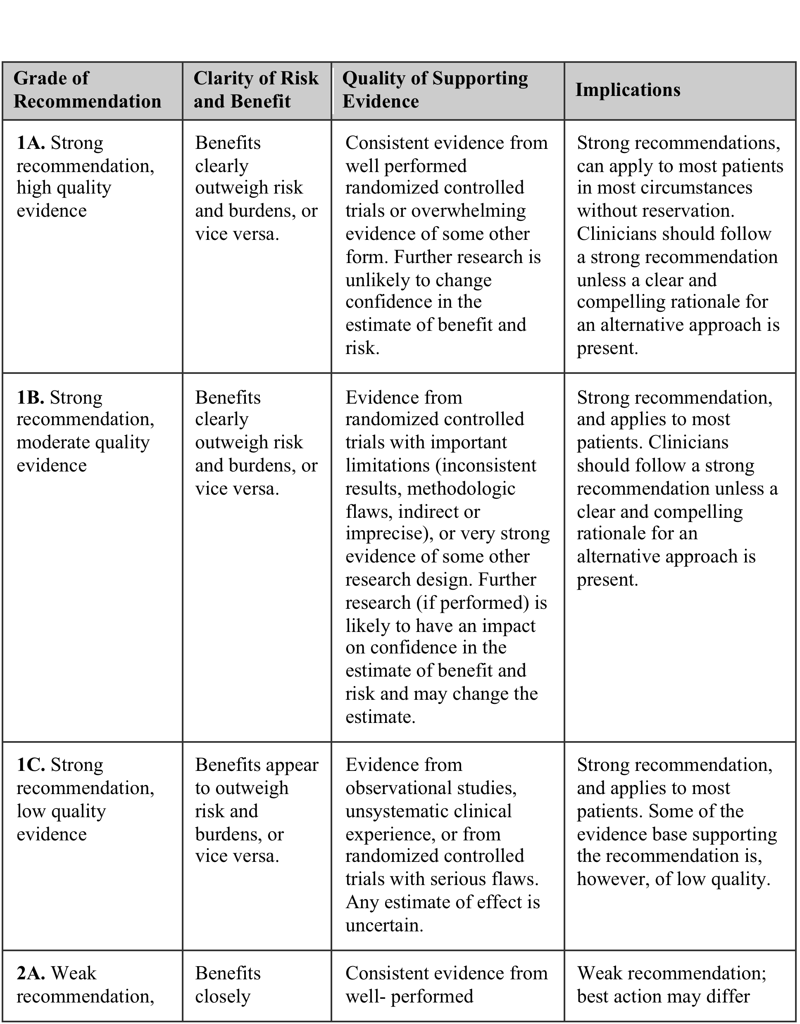
Strength of Recommendations
Notes:
Brian in particular

Slide 28
Disclaimer
The practice of medicine continues to evolve, and individual circumstances will vary. This opinion reflects information available at the time of its submission for publication and is neither designed nor intended to establish an exclusive standard of perinatal care. This presentation is not expected to reflect the opinions of all members of the Society for Maternal-Fetal Medicine.
These slides are for personal, non-commercial and educational use only
Notes:
Brian in particular

Slide 29
Disclosures
This opinion was developed by a Obstetric Care Consensus Committee consisting of Aaron B. Caughey, MD, PhD; Alison G. Cahill, MD, MSCE; Jeanne-Marie Guise, MD, MPH; and Dwight J. Rouse, MD and reviewed by members of the ACOG Committee on Obstetric Practice, ACOG Obstetric Practice Bulletins Committee, and the Publications Committee of the Society for Maternal Fetal Medicine who have all submitted a conflict of interest disclosure delineating personal, professional, and/or business interests that might be perceived as a real or potential conflict of interest in relation to this publication.
Notes:
Brian in particular

